Slide 1
DALLAS WEST CHURCH OF CHURCH

Slide 2
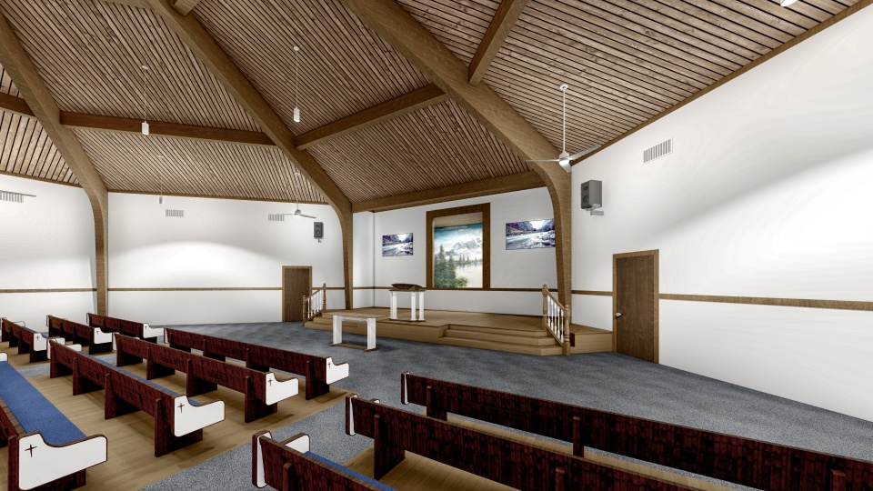

Slide 3
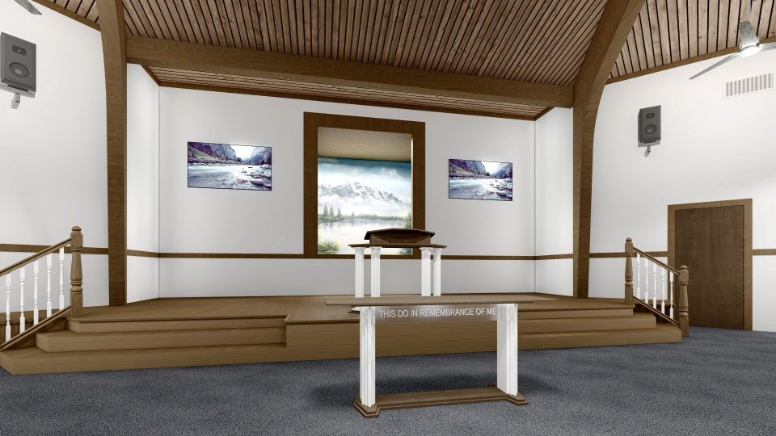

Slide 4
LAWRENCE AND MARDER CHURCH OF CHURCH

Slide 5
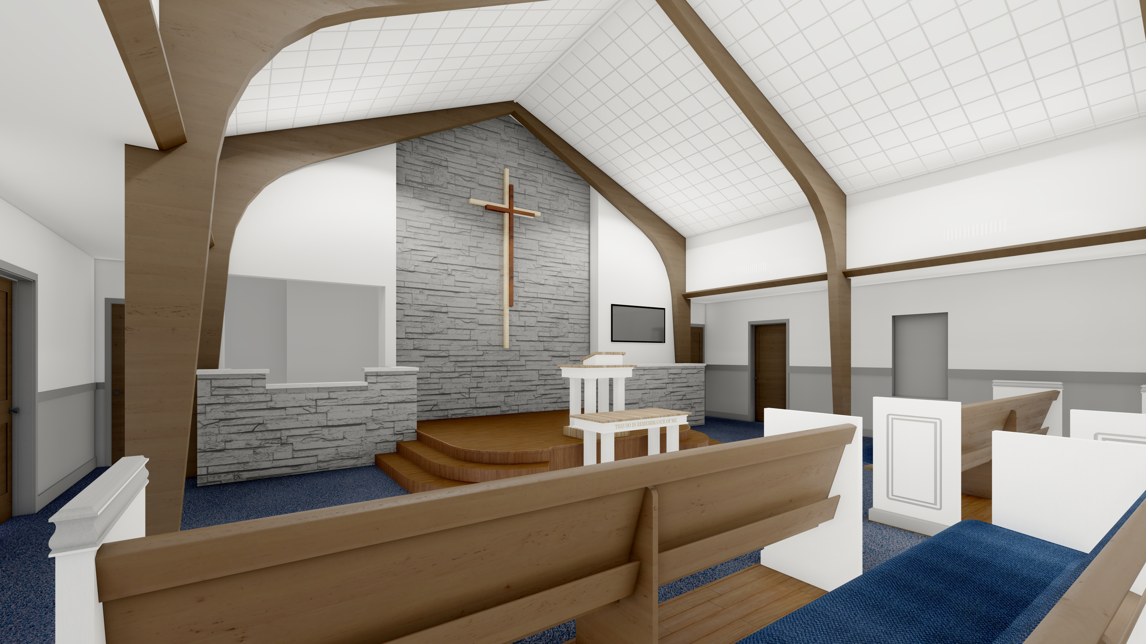

Slide 6
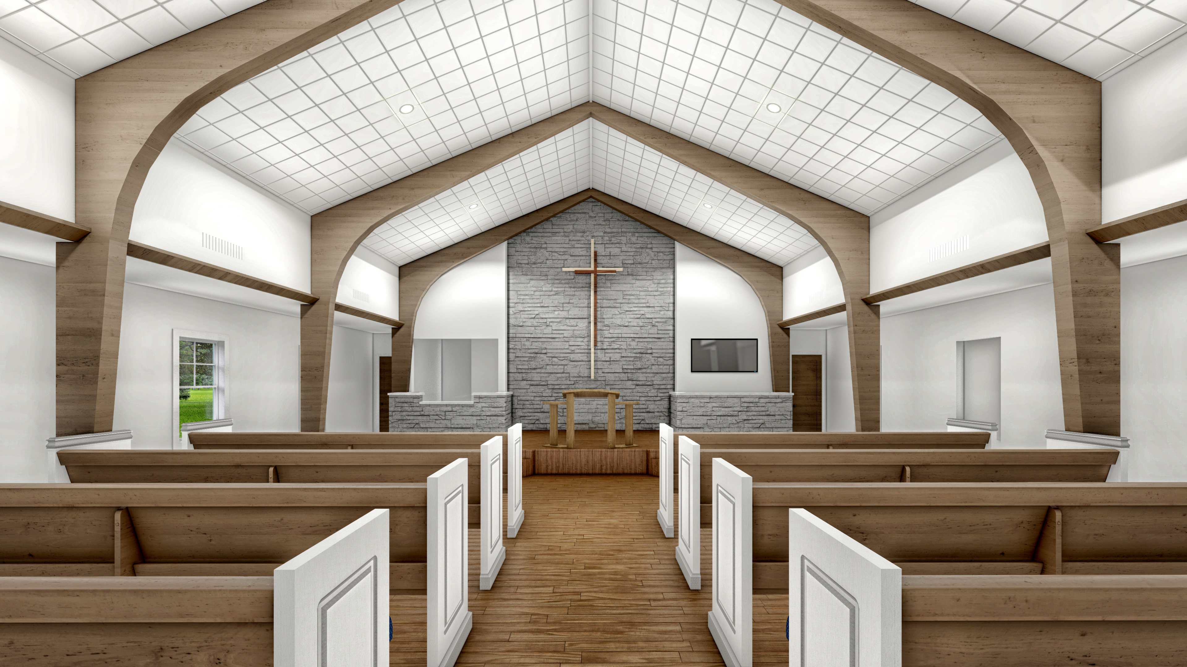

Slide 7
MARSALIS STREET CHURCH OF CHURCH

Slide 8
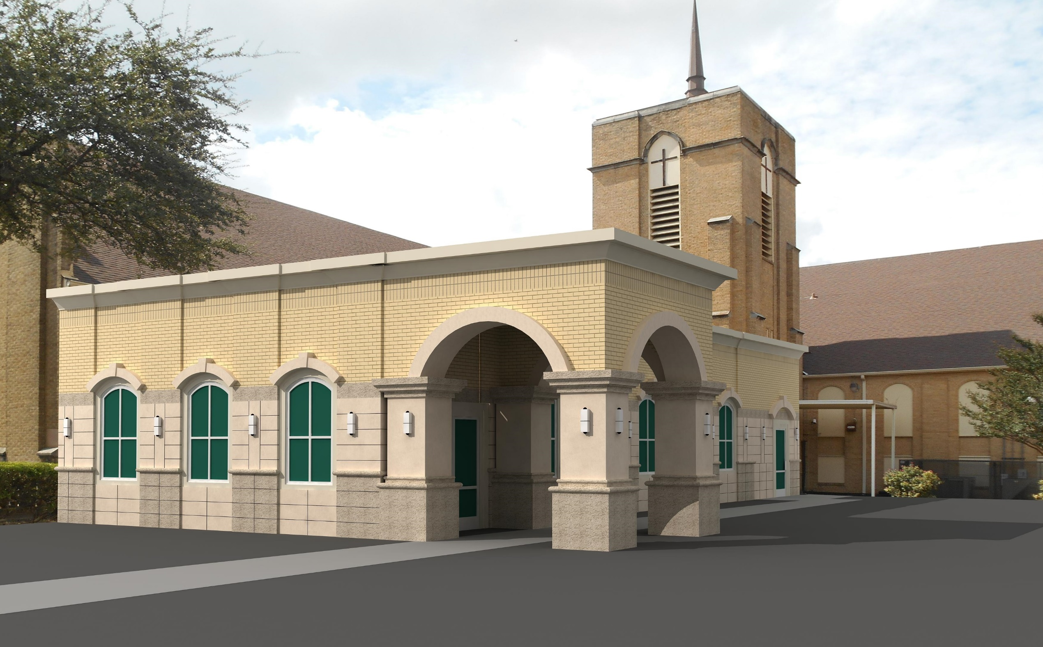

Slide 9
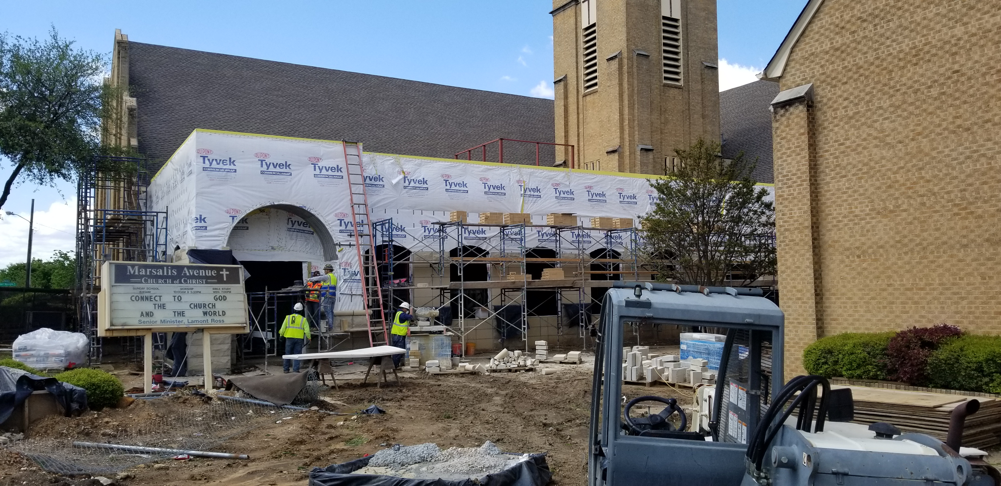

Slide 10
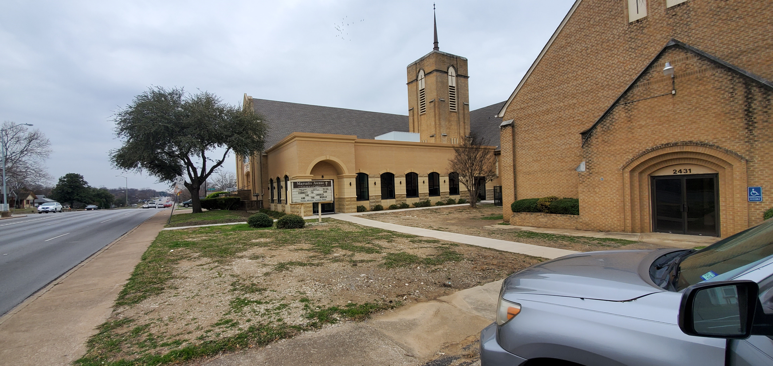

Slide 11
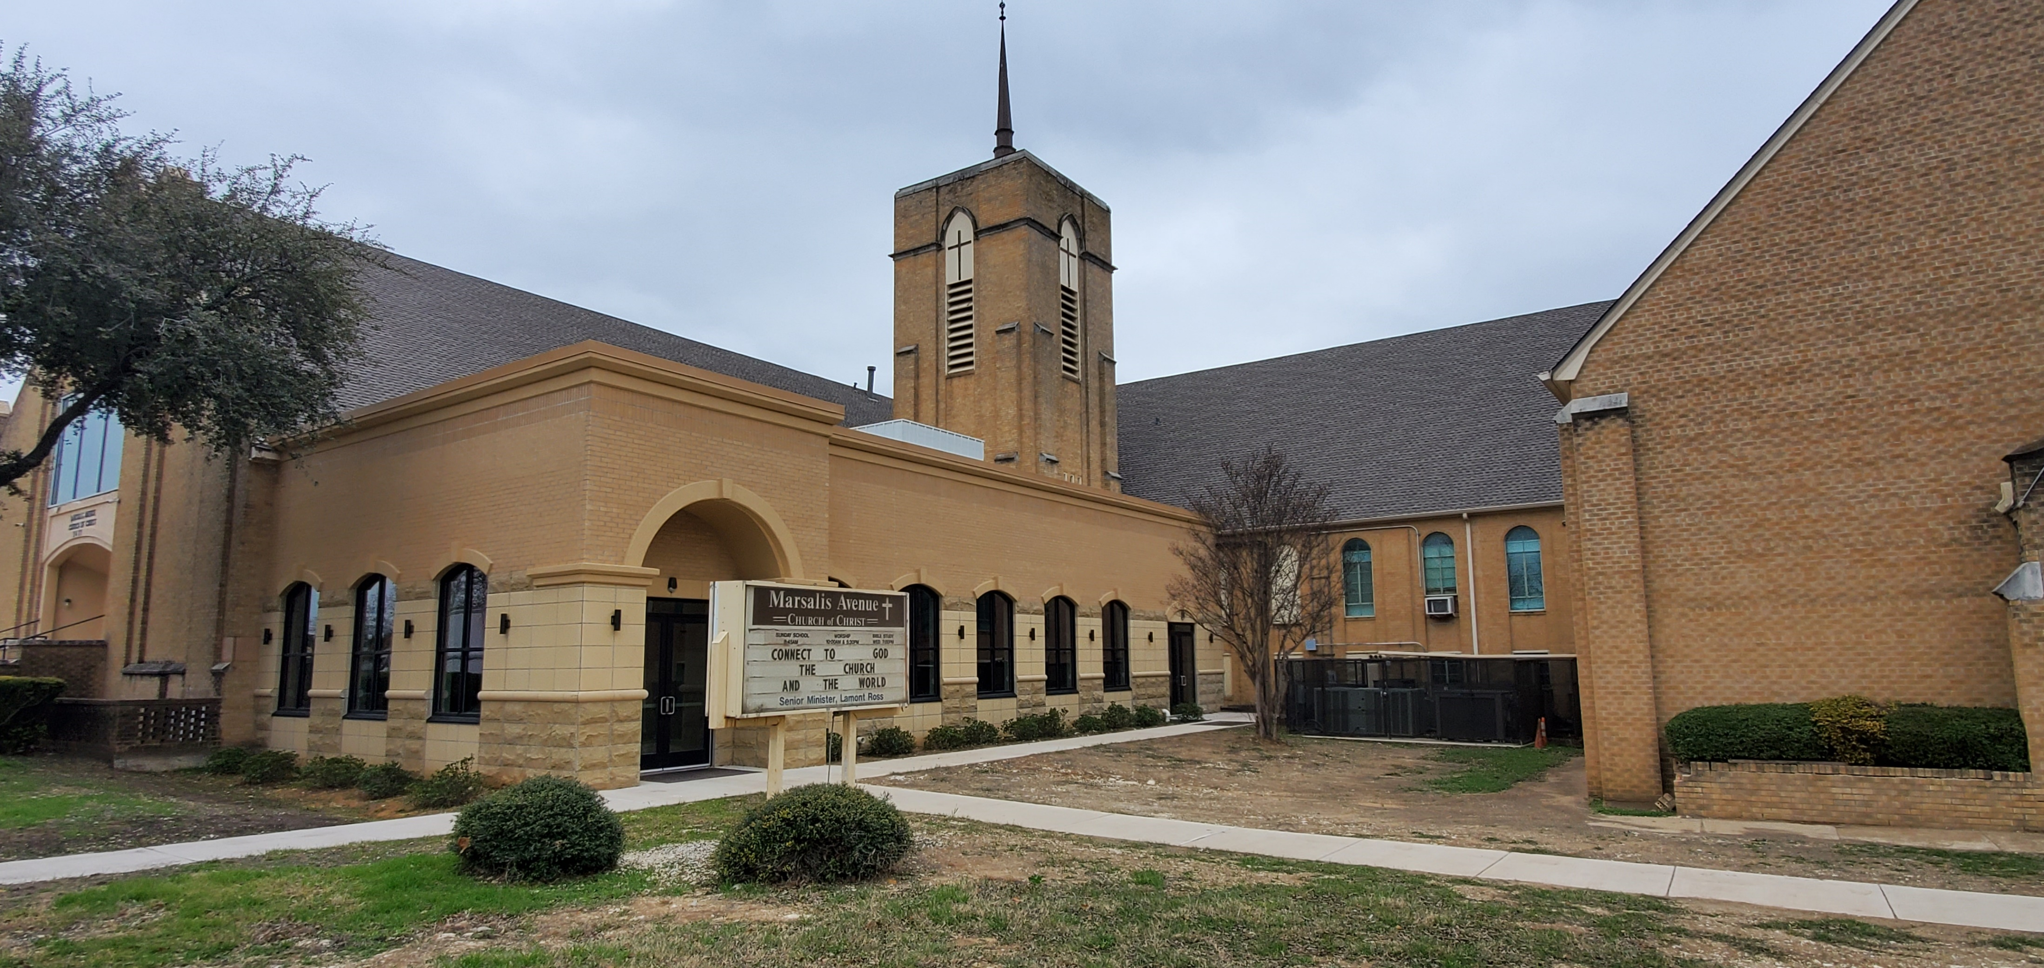

Slide 12
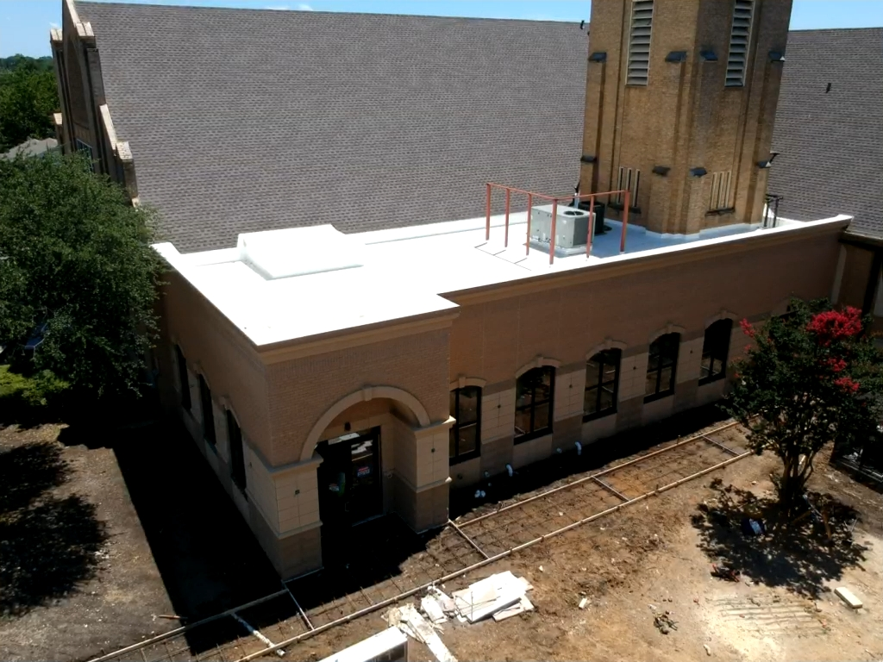

Slide 14
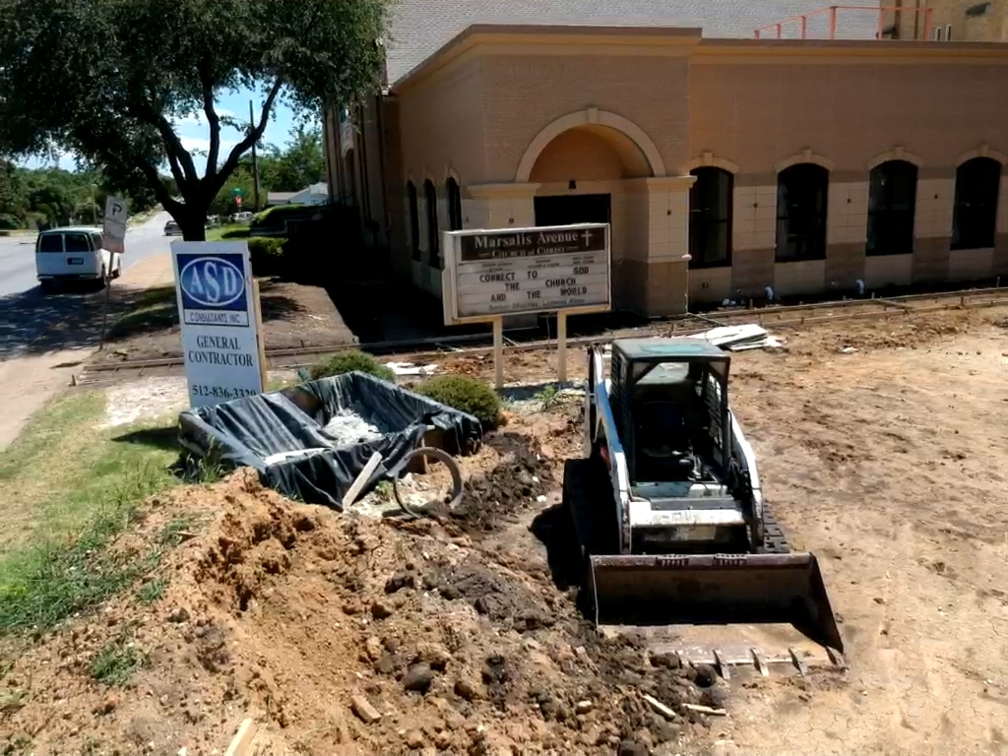

Slide 15
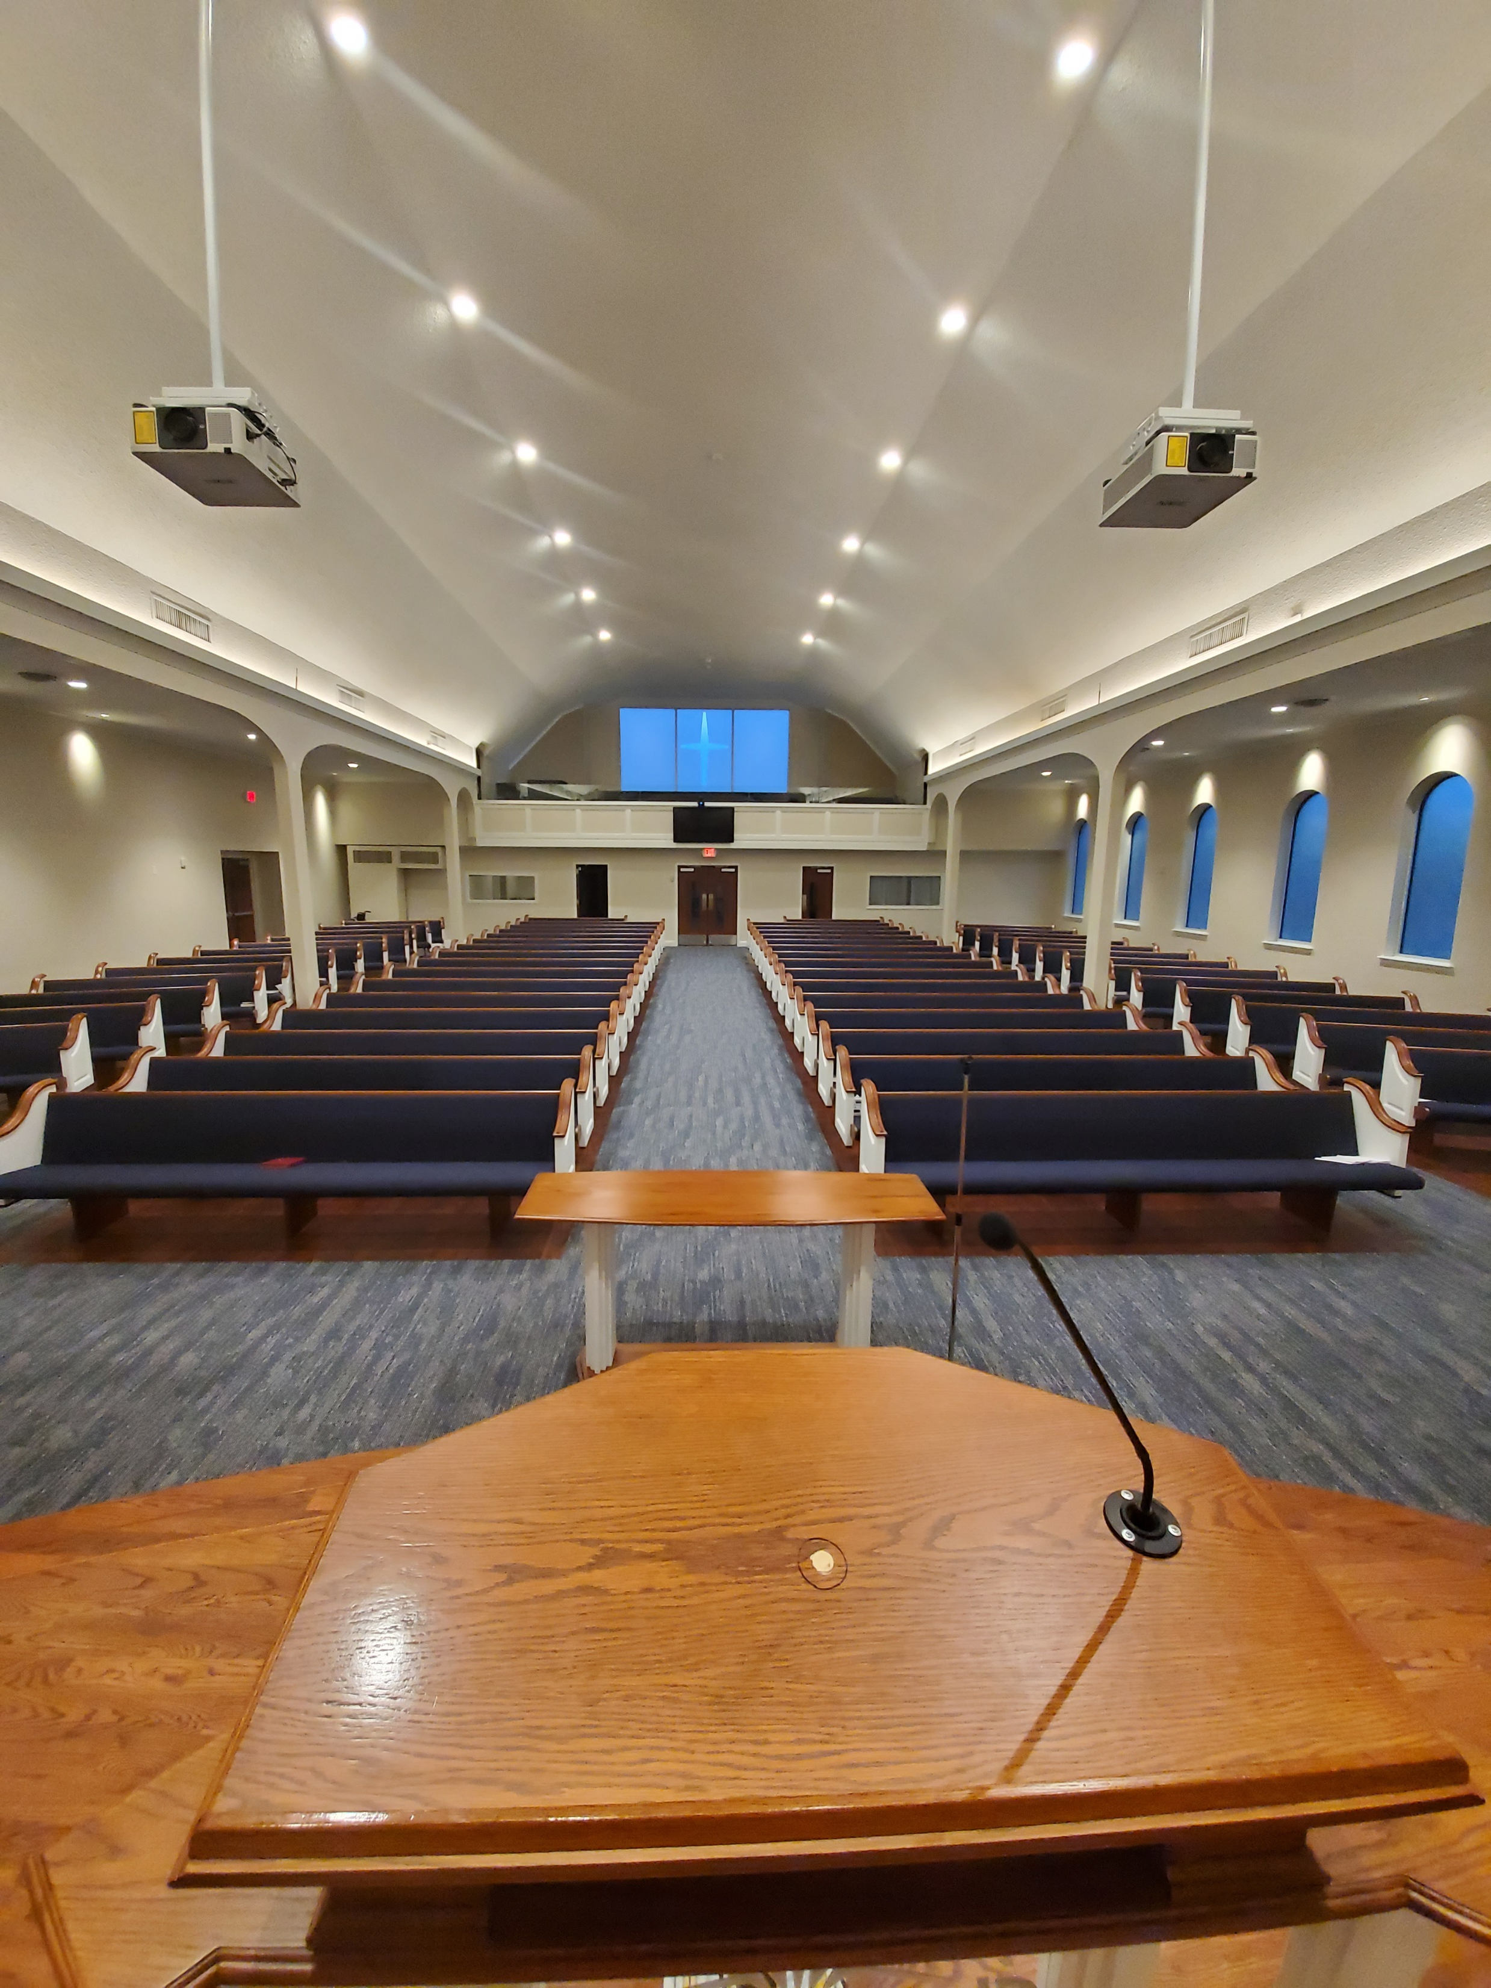

Slide 16
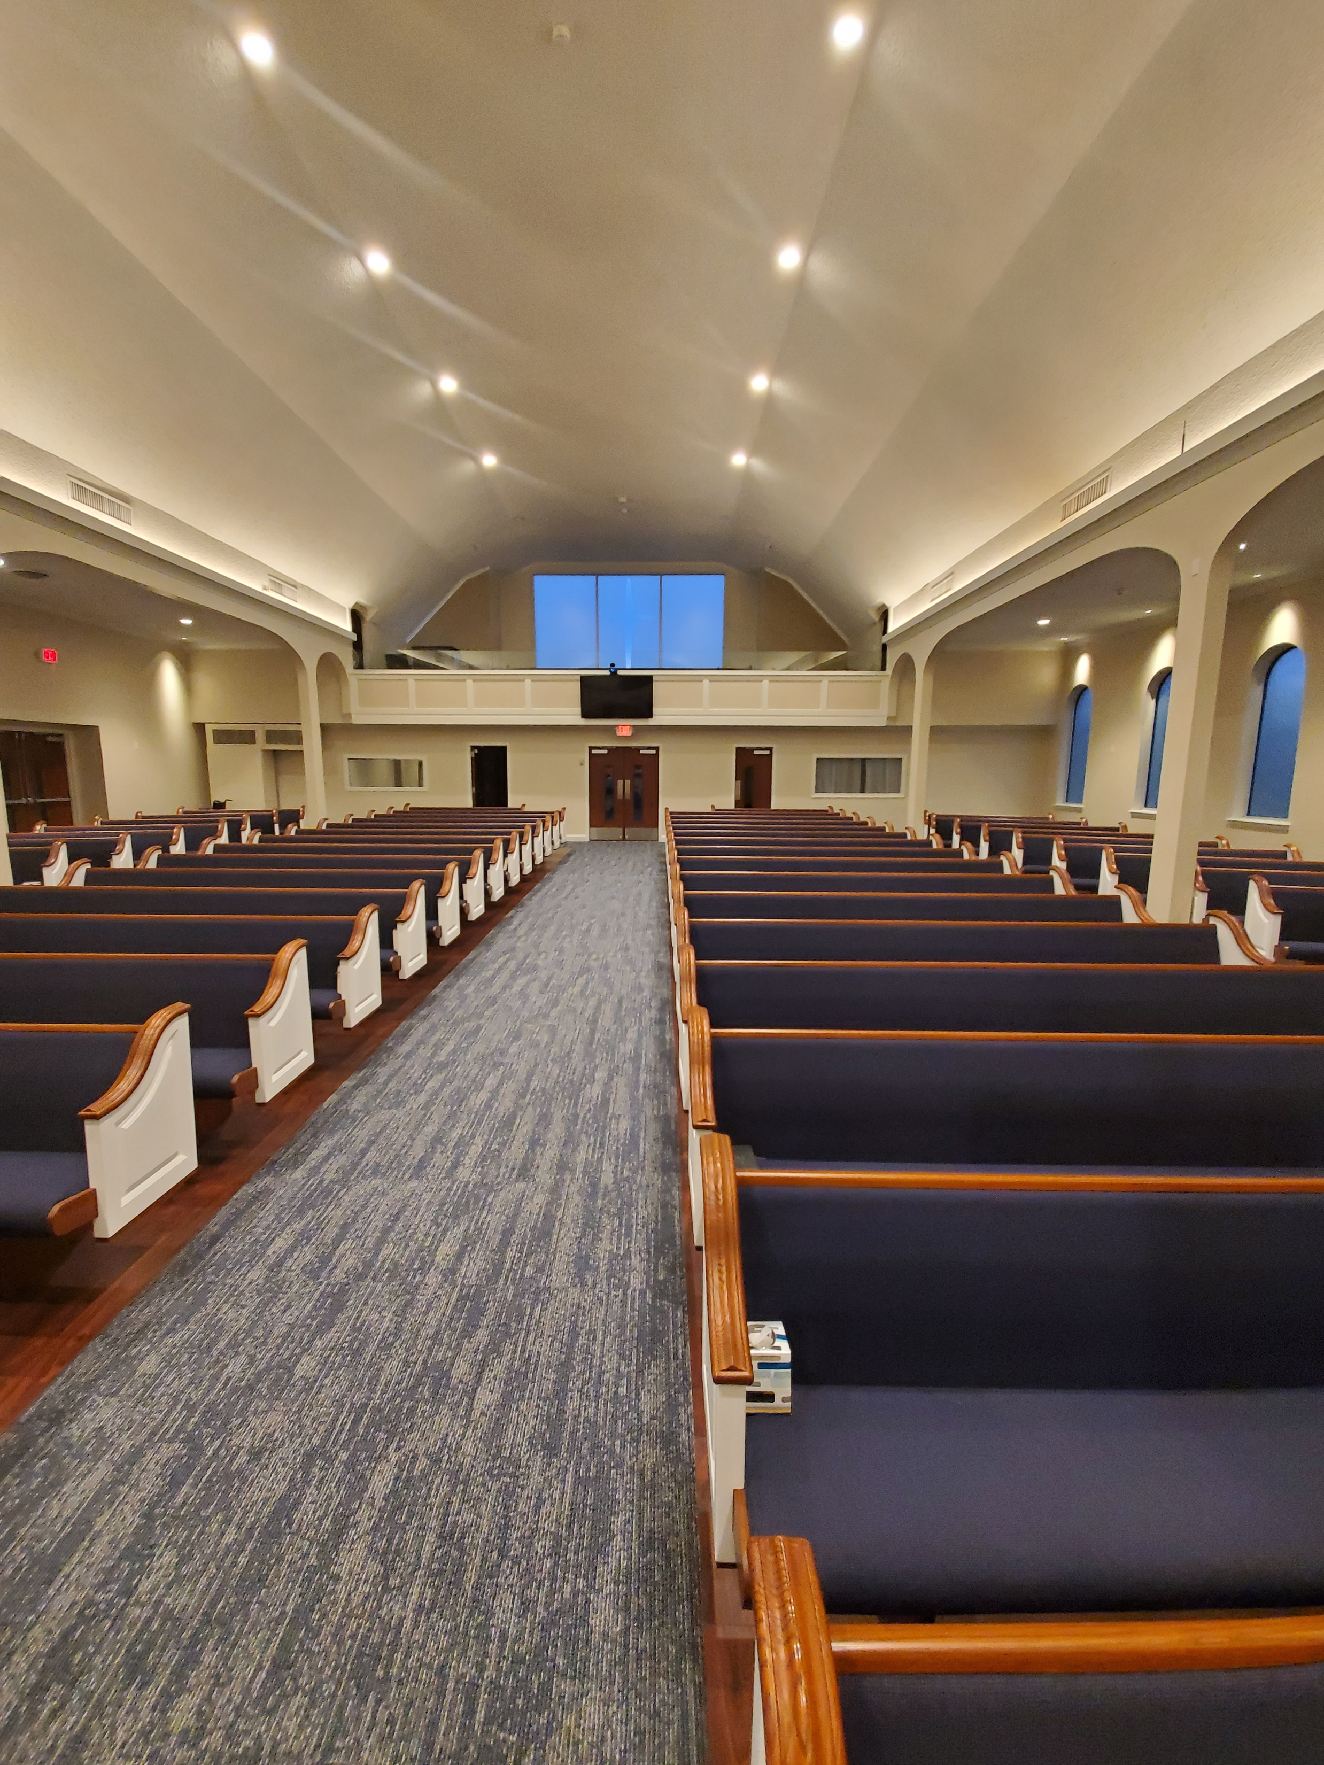

Slide 17
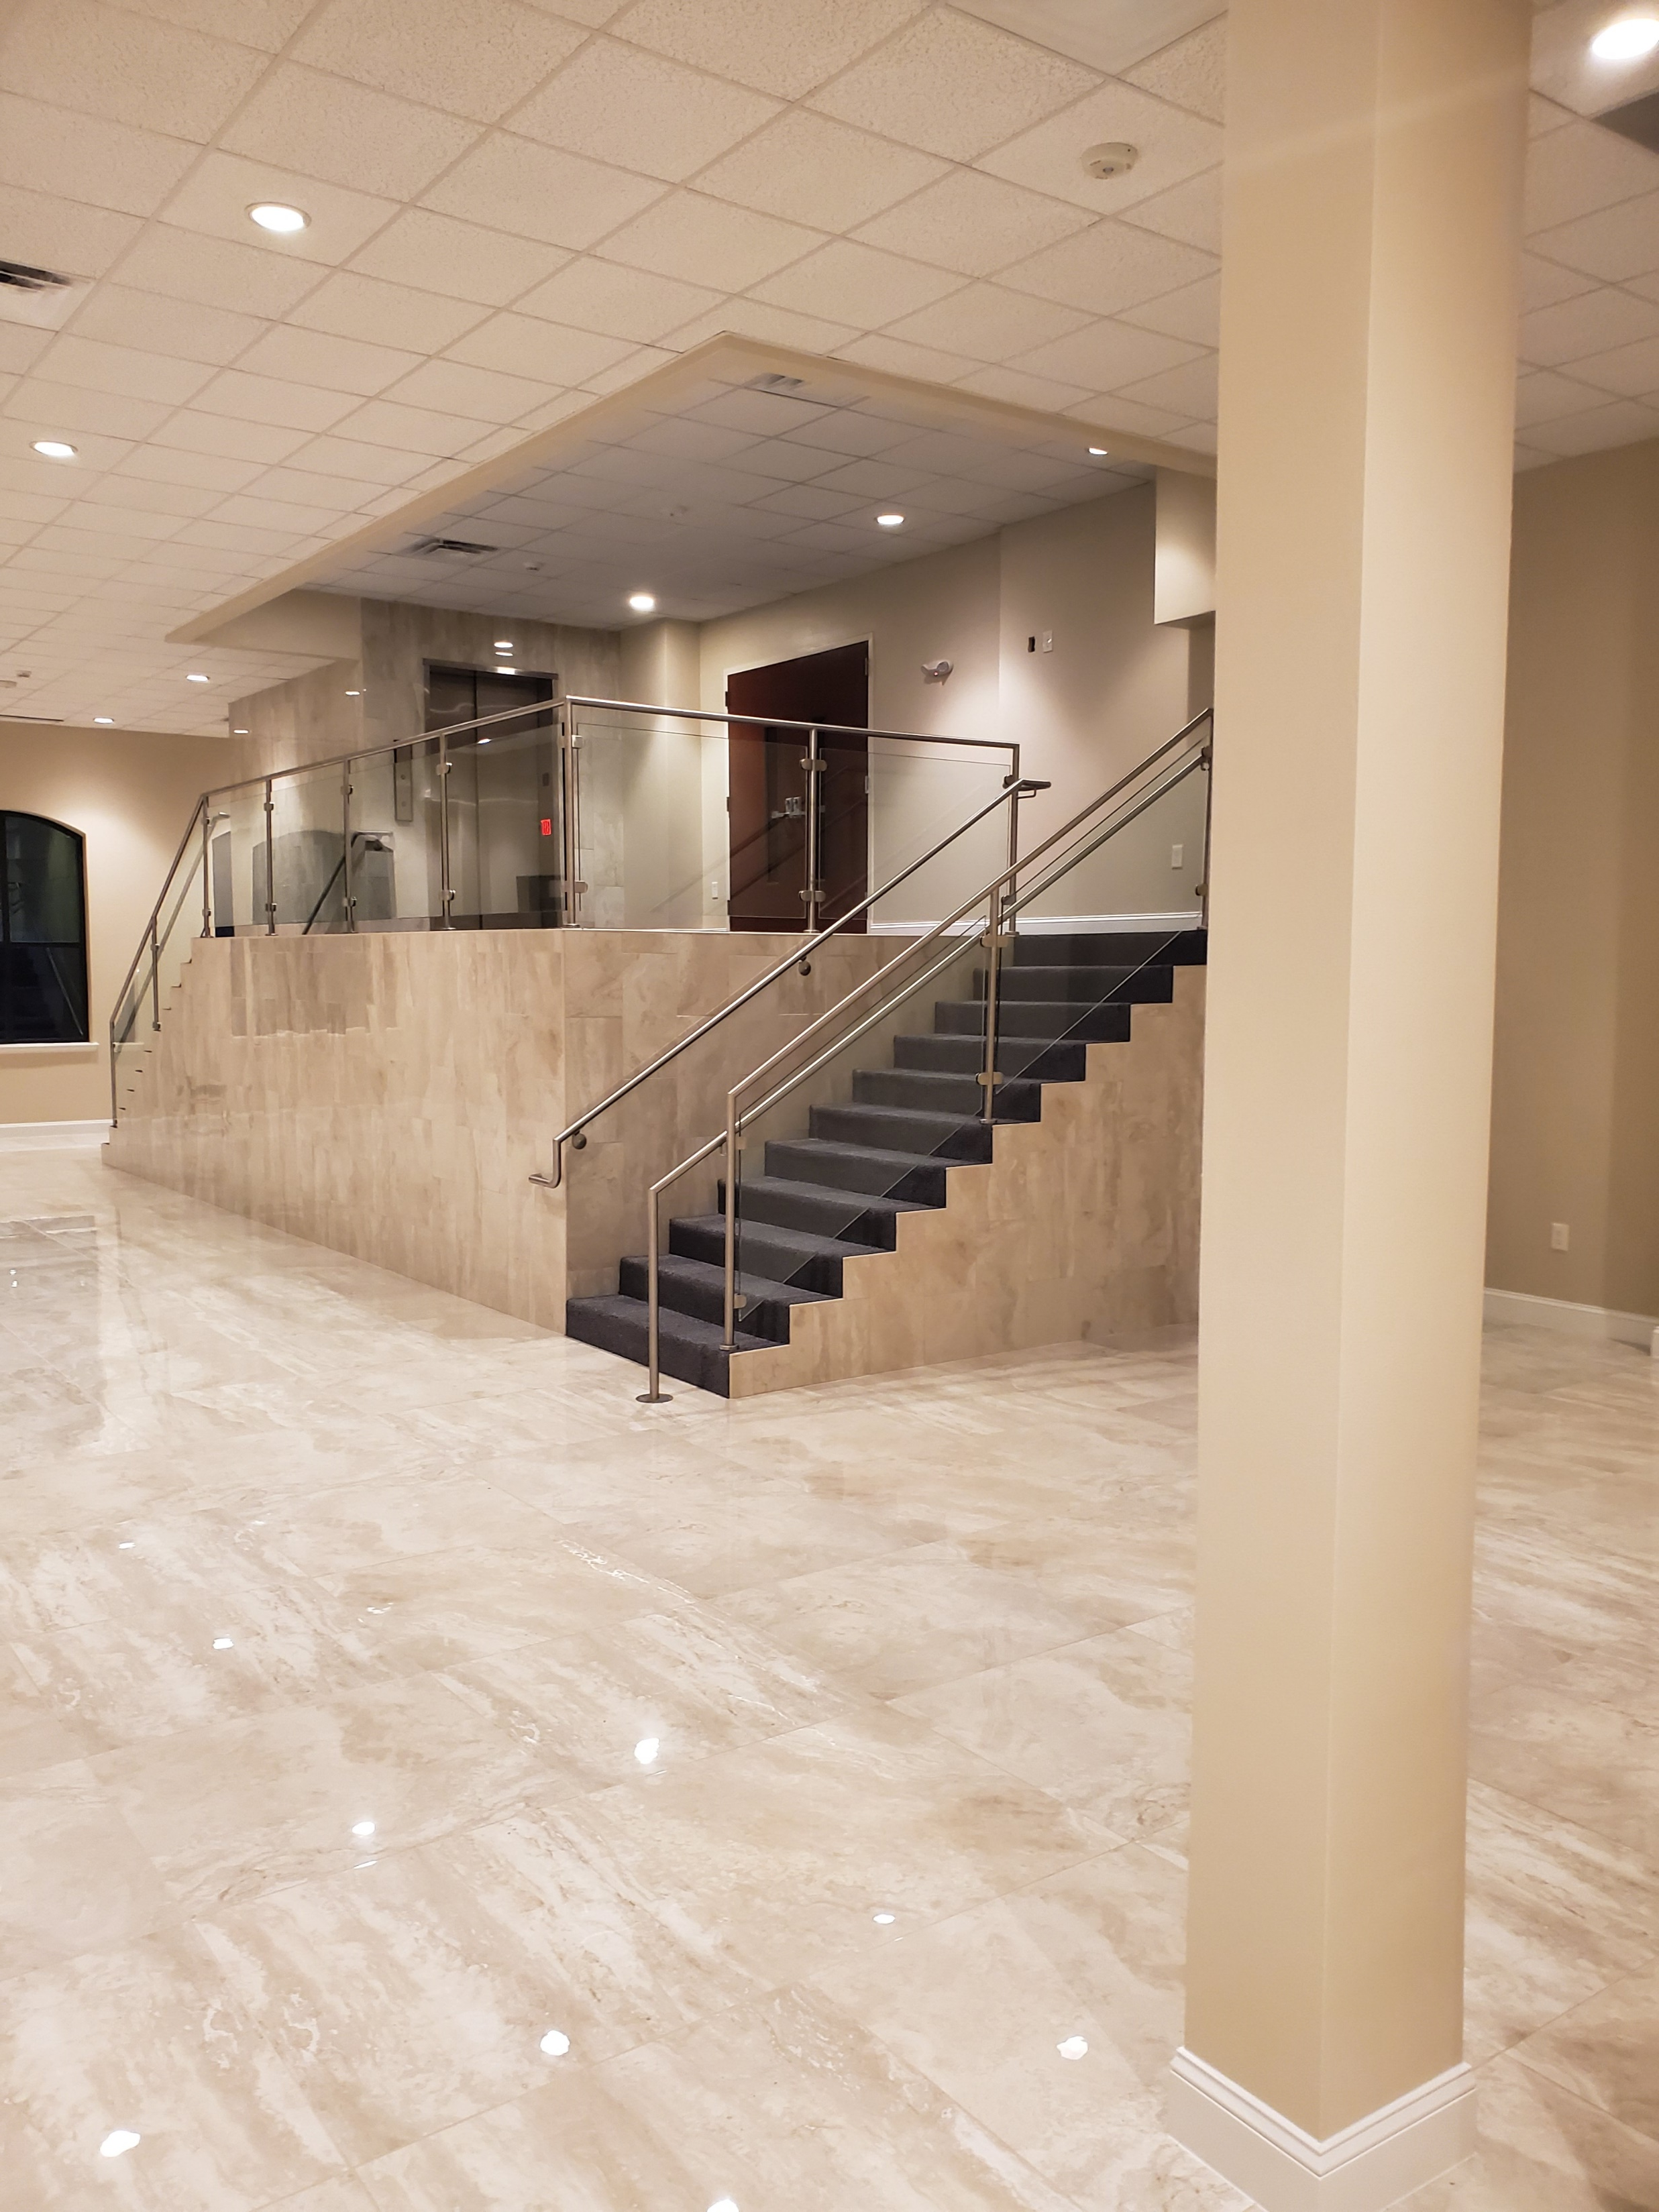

Slide 18
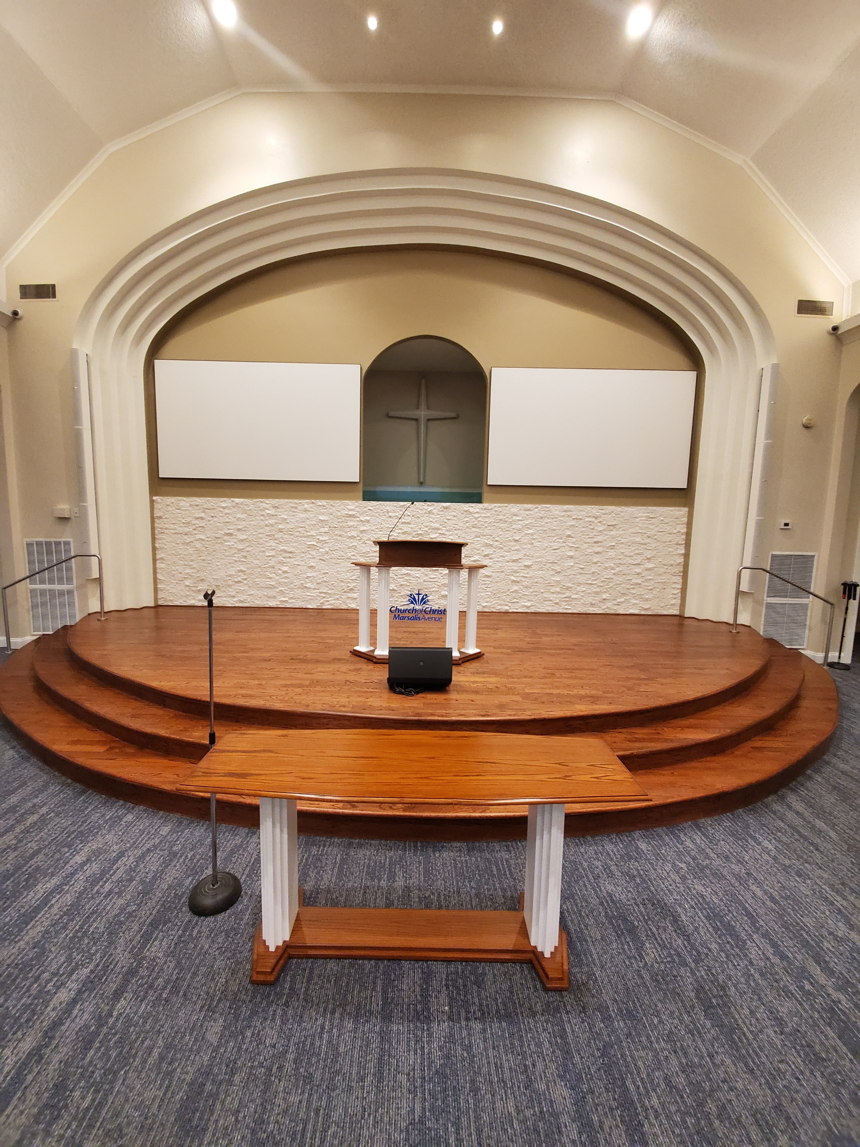

Slide 19
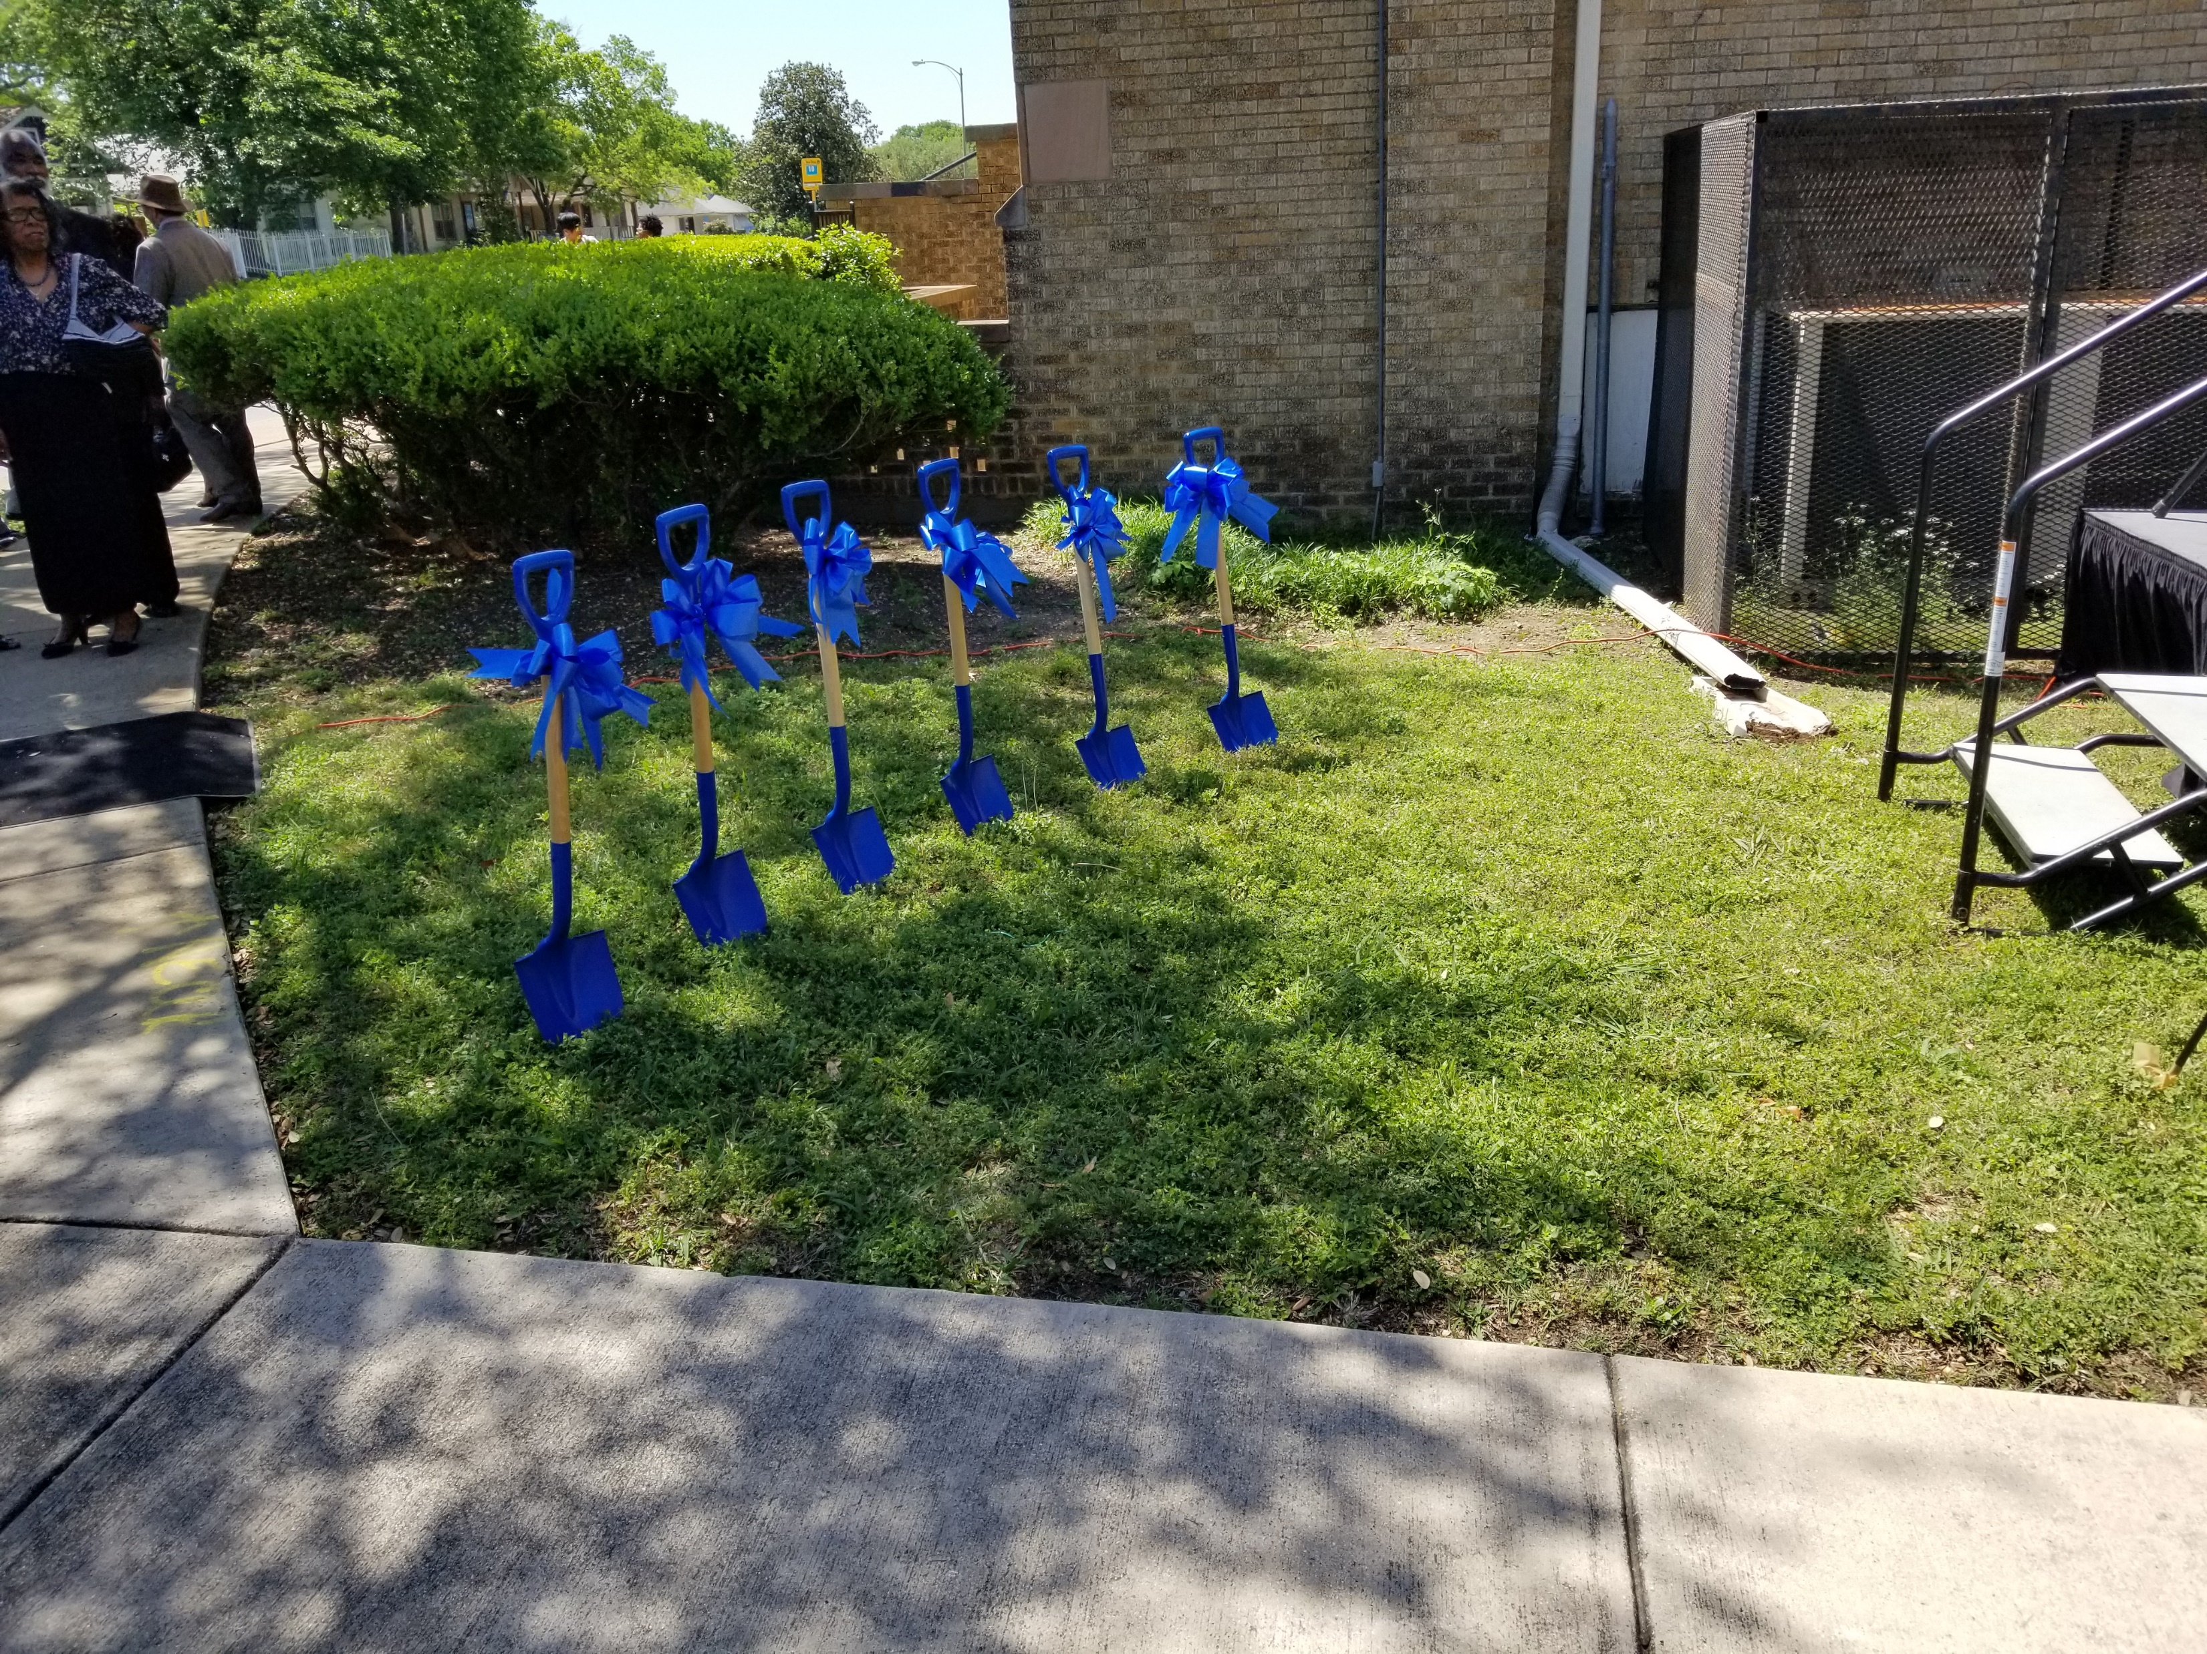

Slide 20
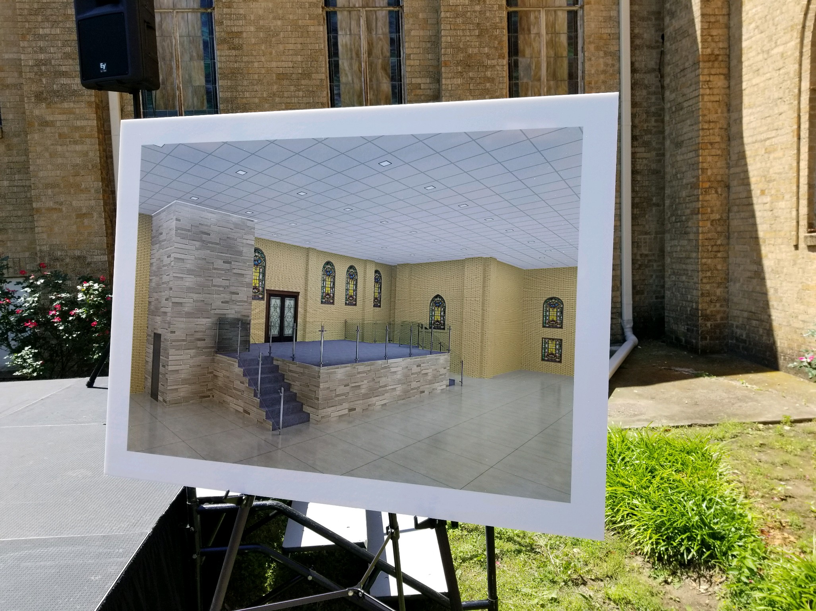

Slide 21
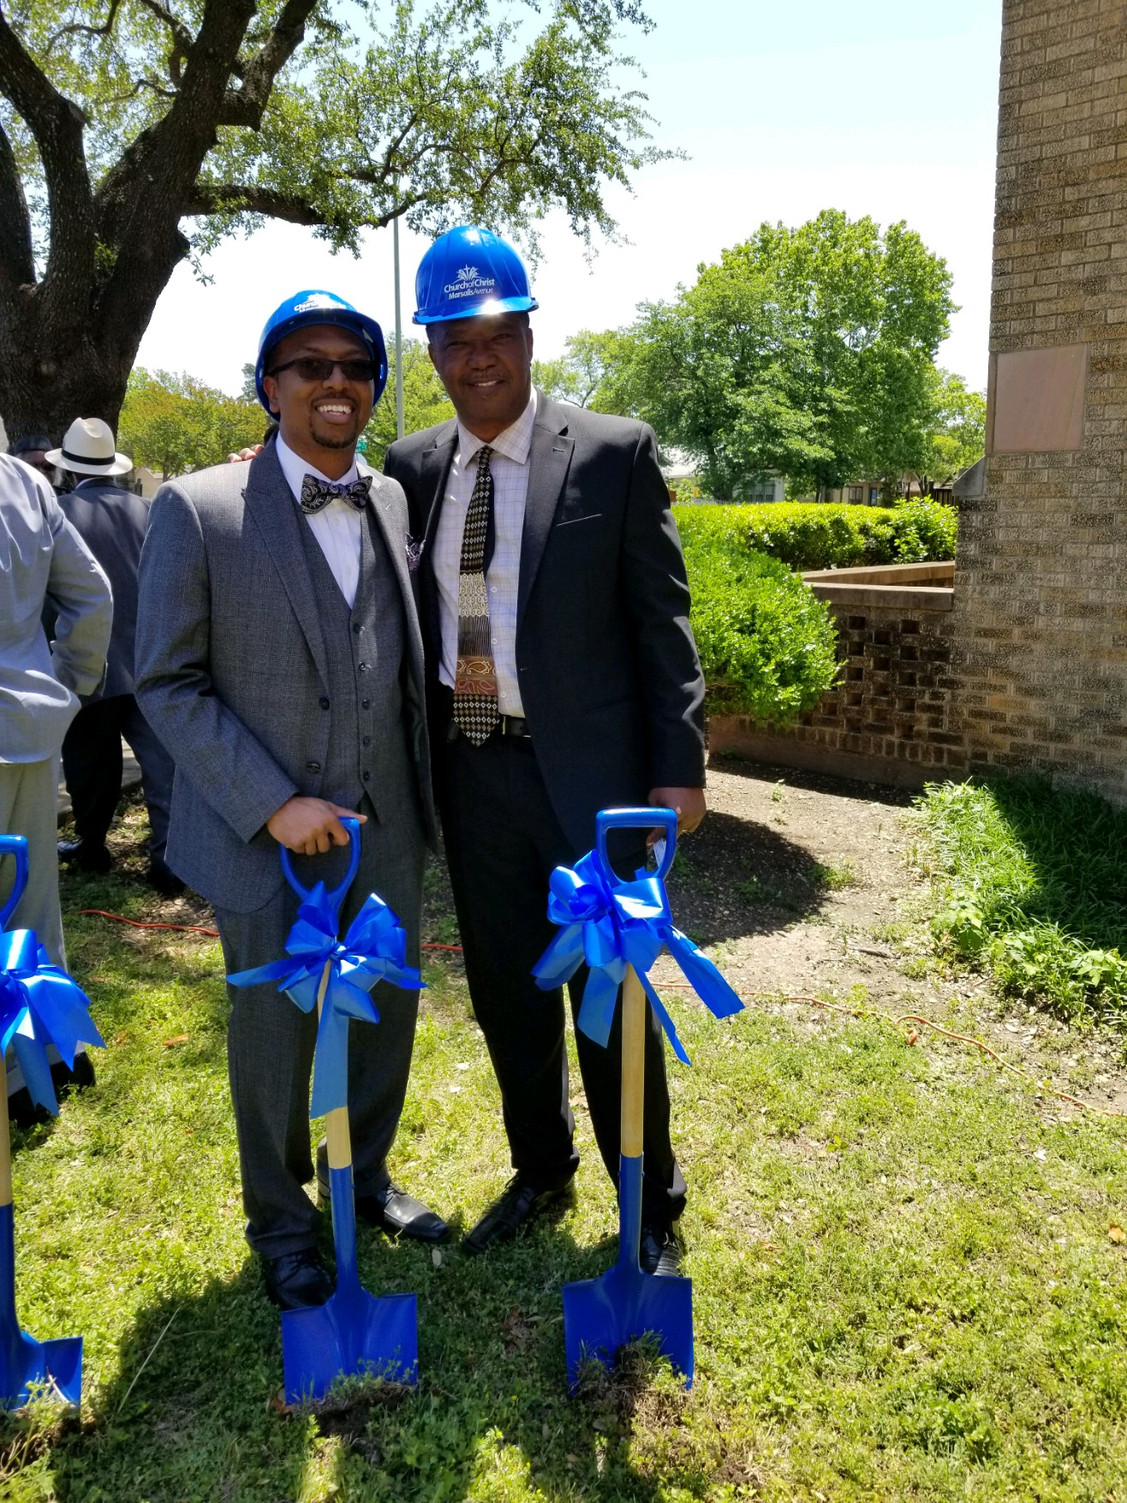

Slide 22
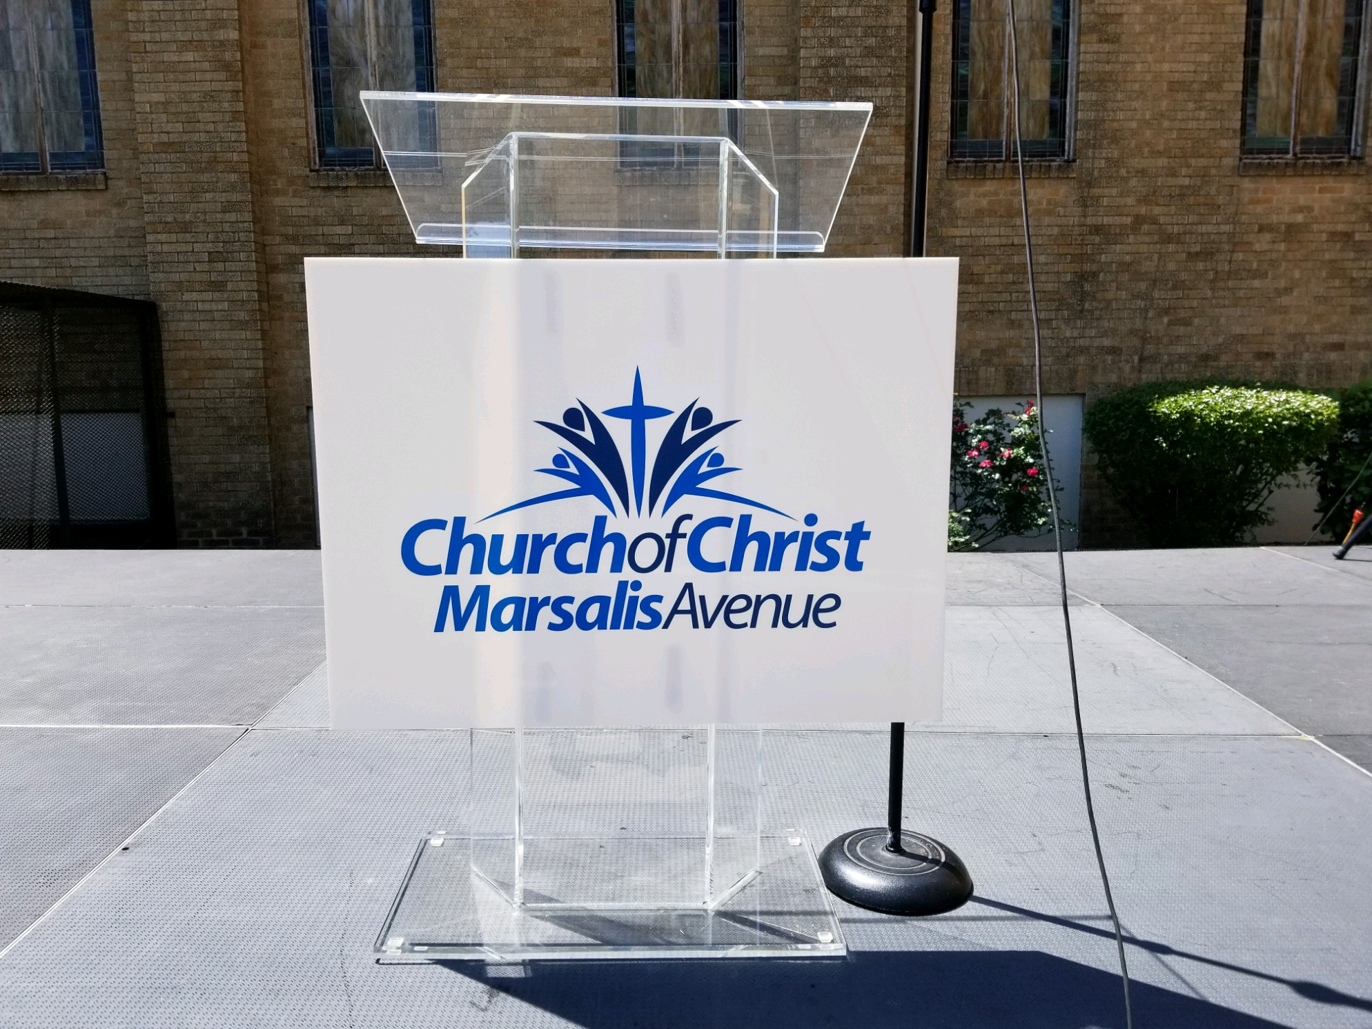

Slide 23
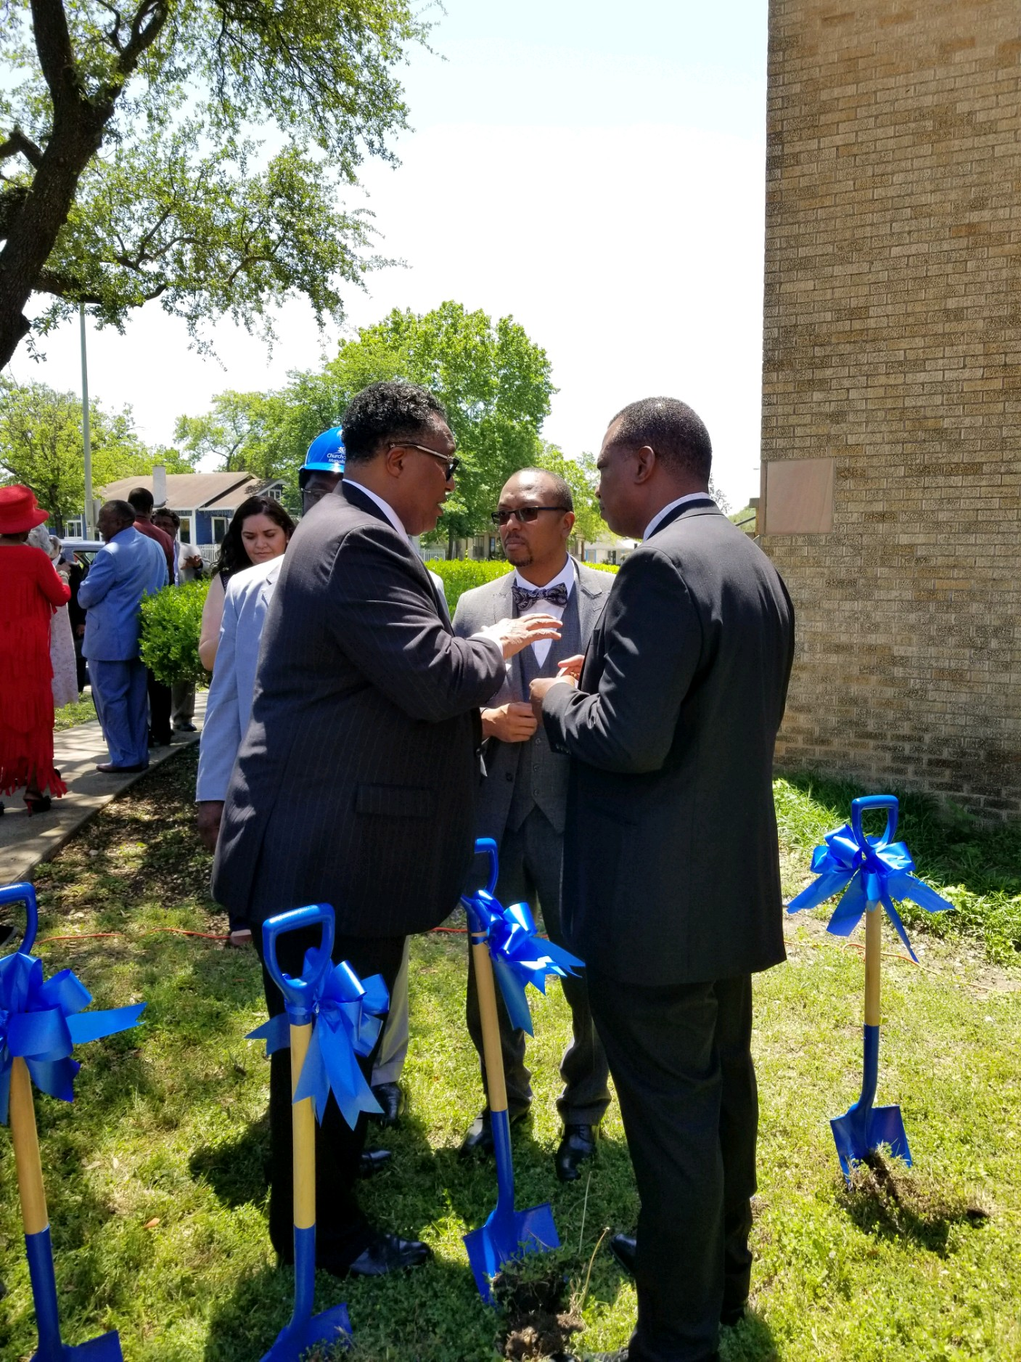

Slide 24
CLOVERLAND CHURCH OF CHRIST

Slide 25
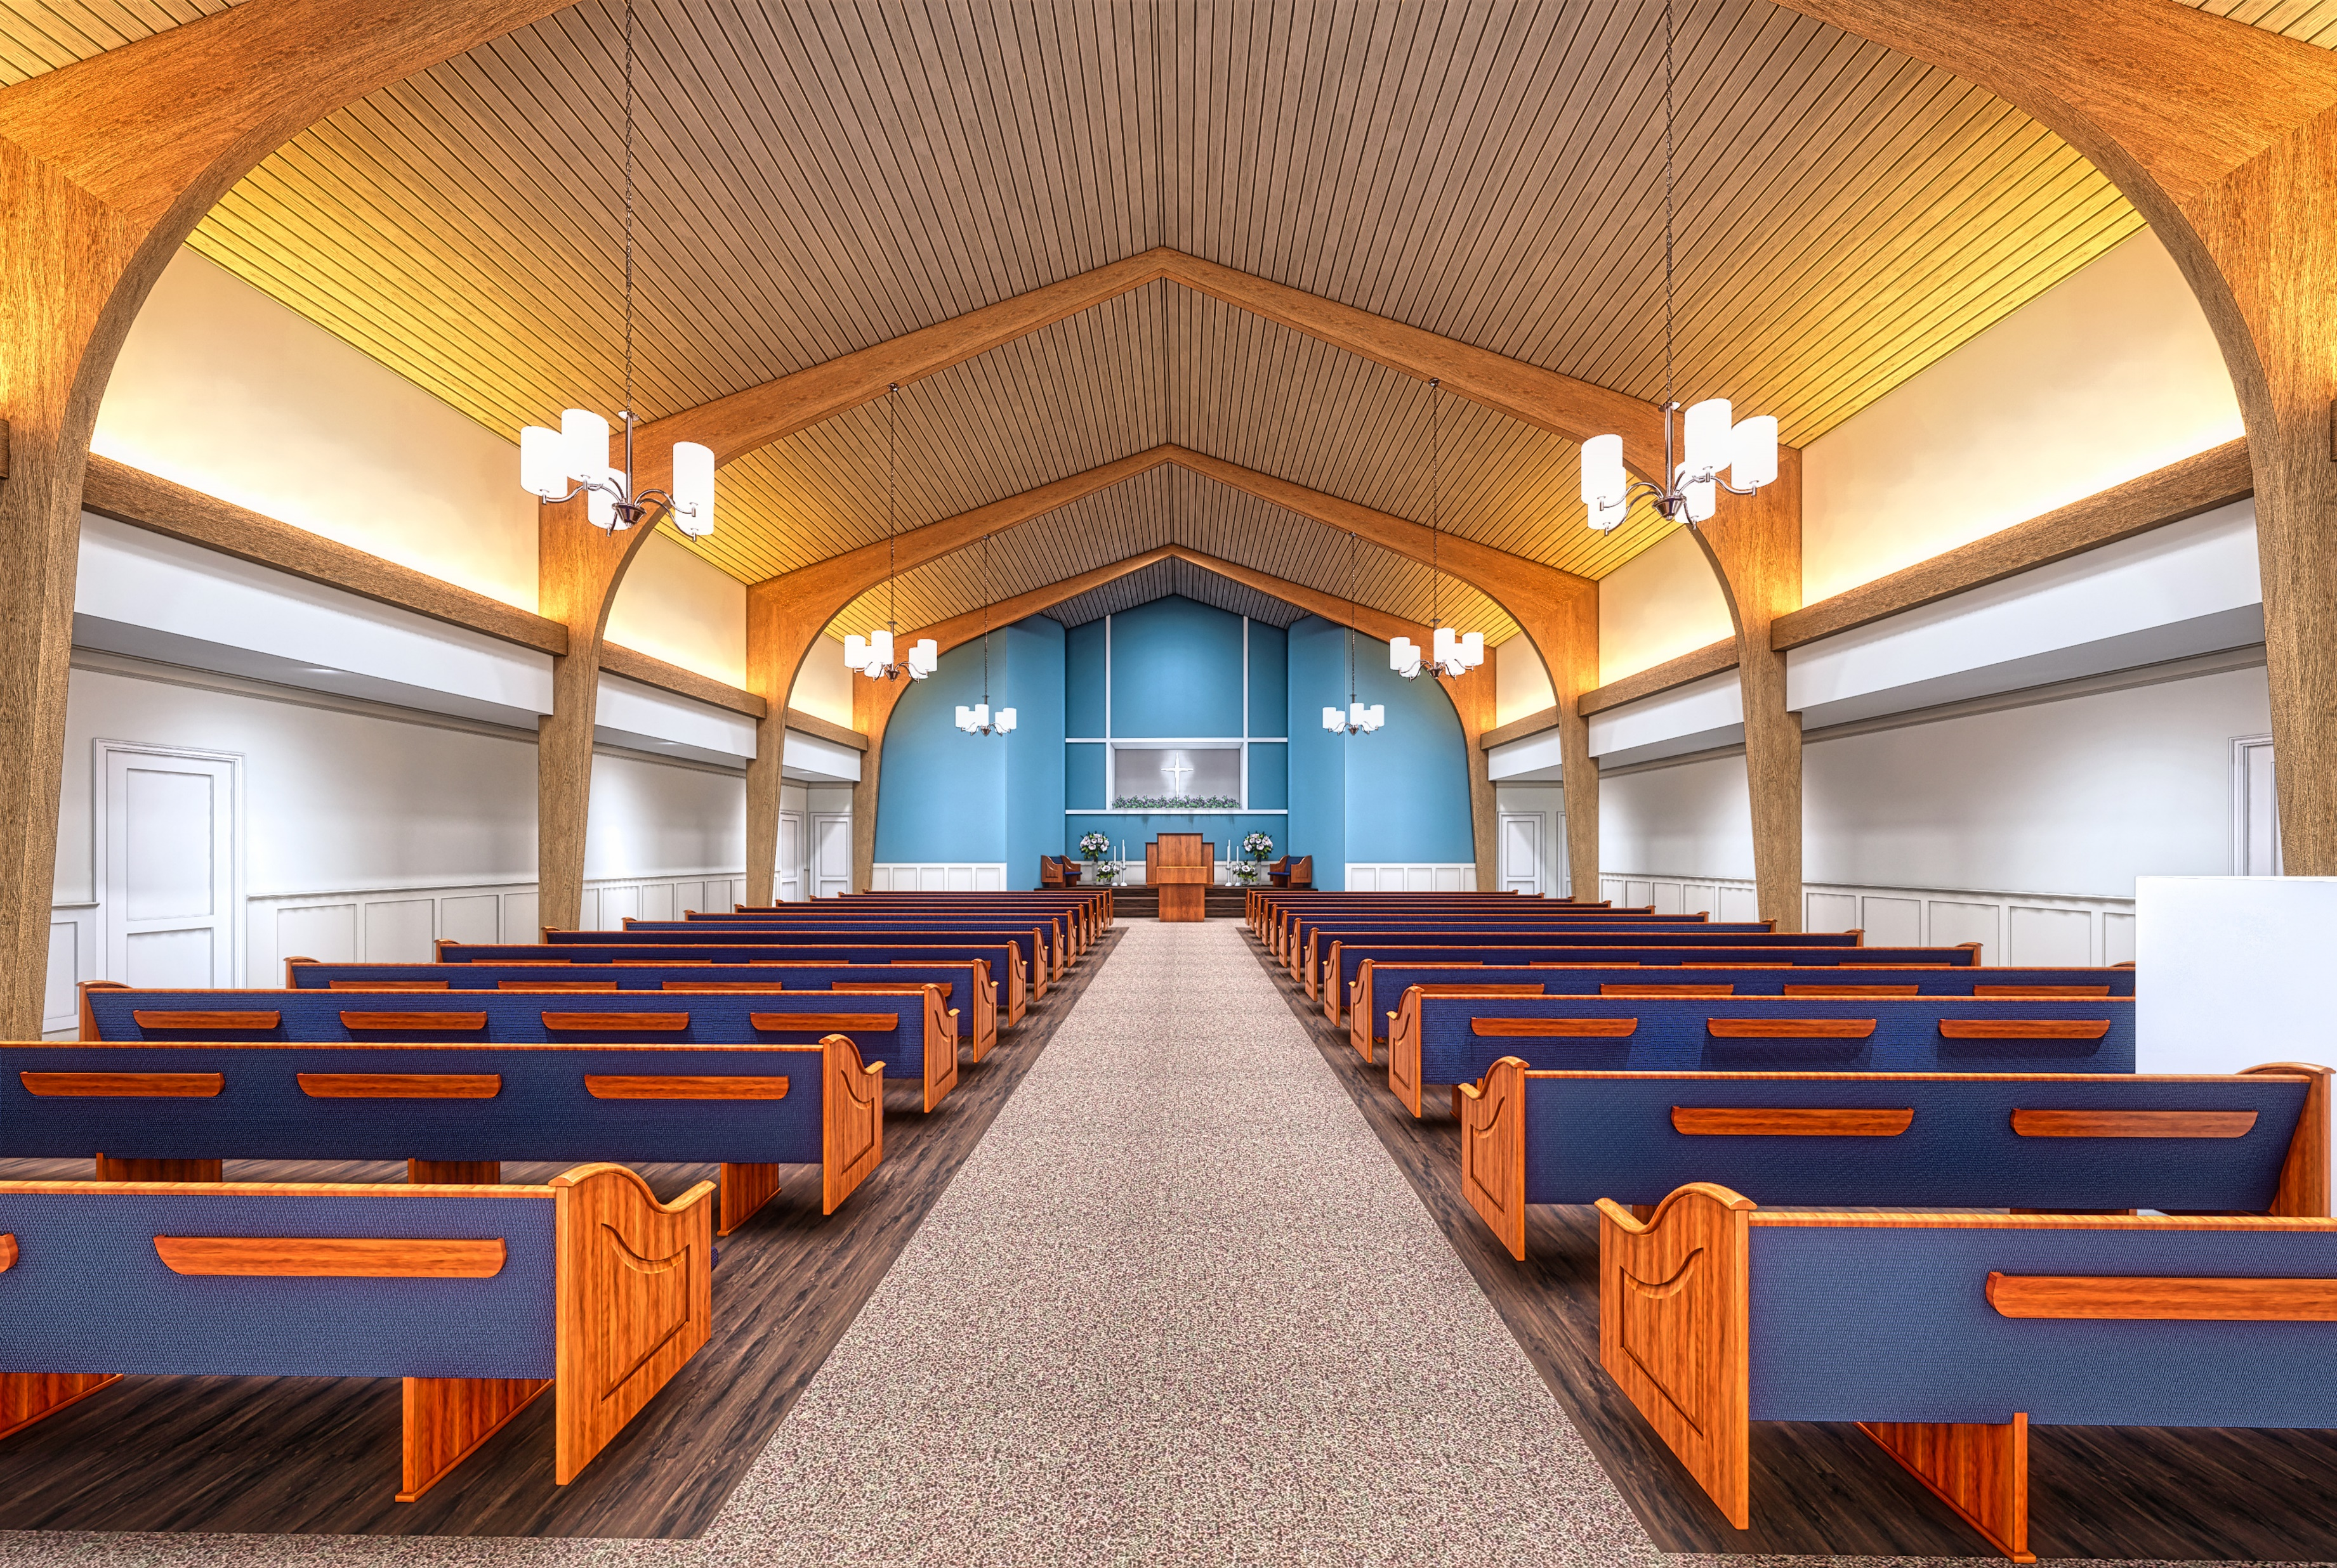

Slide 26
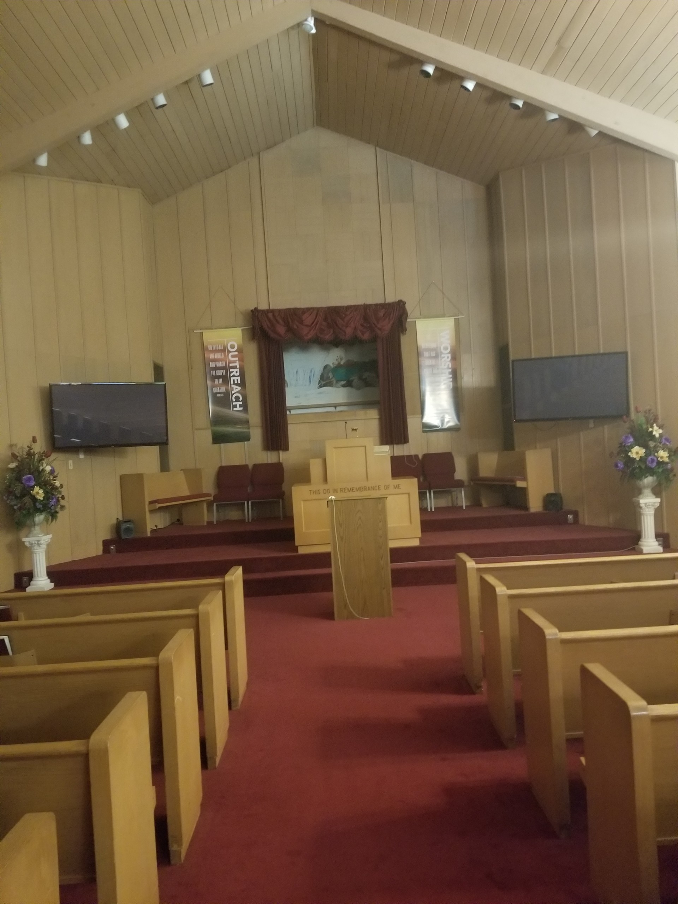

Slide 27
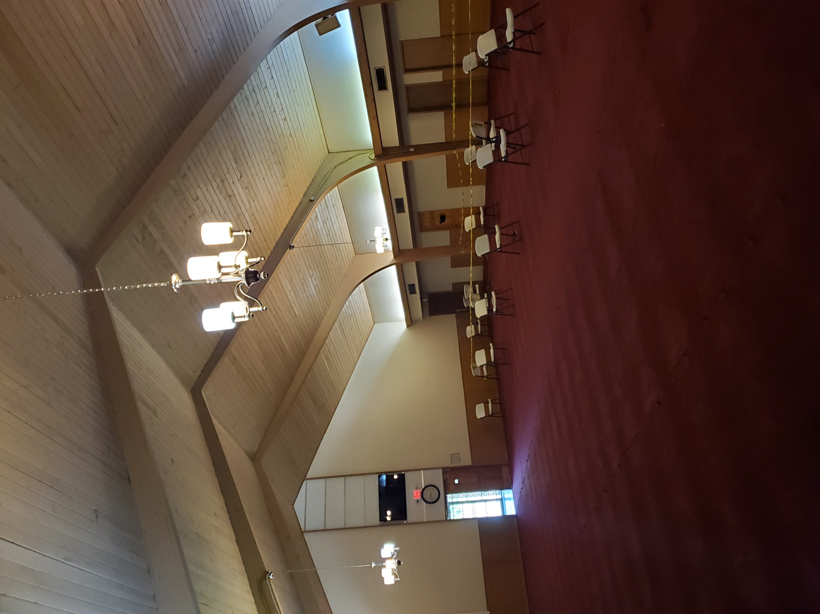

Slide 31
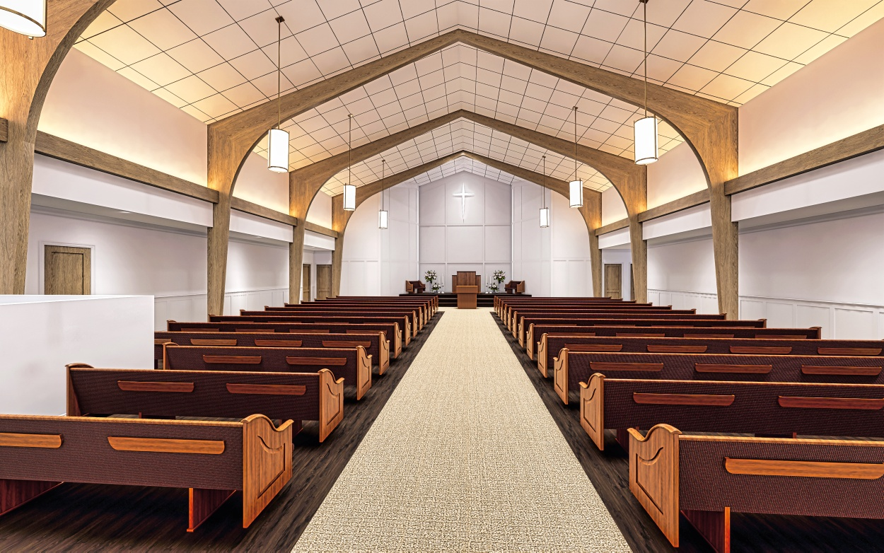

Slide 33
GREENVILLE AVENUE CHURCH OF CHRIST

Slide 41
CHURCH OF CHRIST AT EAST SIDE

Slide 42
SERVICES PROVIDED/COMPANY HISTORY
SERVICES PROVIDED
PROJECT MANAGEMENT
FEASIBILITY STUDIES
CONSTRUCTION MANAGEMENT
COST ESTIMATING
ROOF CONSULTING
ARCHITECTURE
DESIGN/BUILD
GENERAL CONSTRUCTION
CM@ RISK
Church of Christ at East Side, Austin, TX $4M
ESTABLISHED OFFICES
1994 AUSTIN, TX
2007 San Antonio, TX
2007 Durham, NC
Parking Church of Christ at East Side $4M
www.asdconsultantsinc.com

Slide 43
SERVICES PROVIDED/COMPANY HISTORY
SERVICES PROVIDED
PROJECT MANAGEMENT
FEASIBILITY STUDIES
CONSTRUCTION MANAGEMENT
COST ESTIMATING
ROOF CONSULTING
ARCHITECTURE
DESIGN/BUILD
GENERAL CONSTRUCTION
CM@ RISK
Church of Christ at East Side, Austin, TX $4M
ESTABLISHED OFFICES
1994 AUSTIN, TX
2007 San Antonio, TX
2007 Durham, NC
Parking Church of Christ at East Side $4M
www.asdconsultantsinc.com

Slide 48
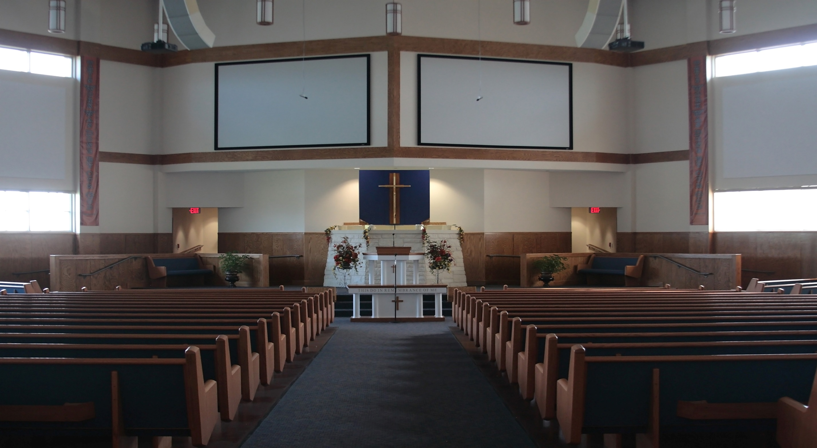

Slide 49
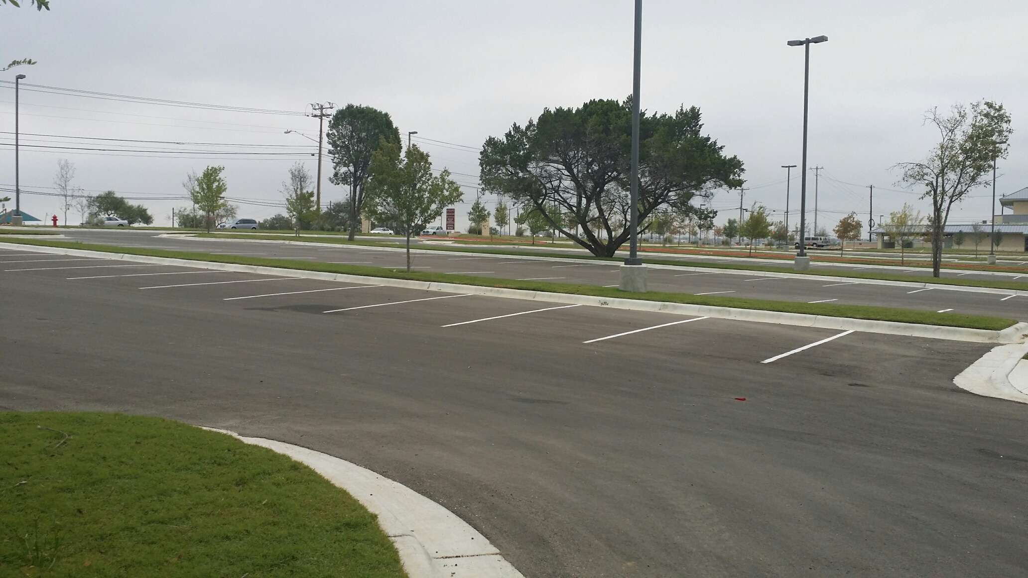
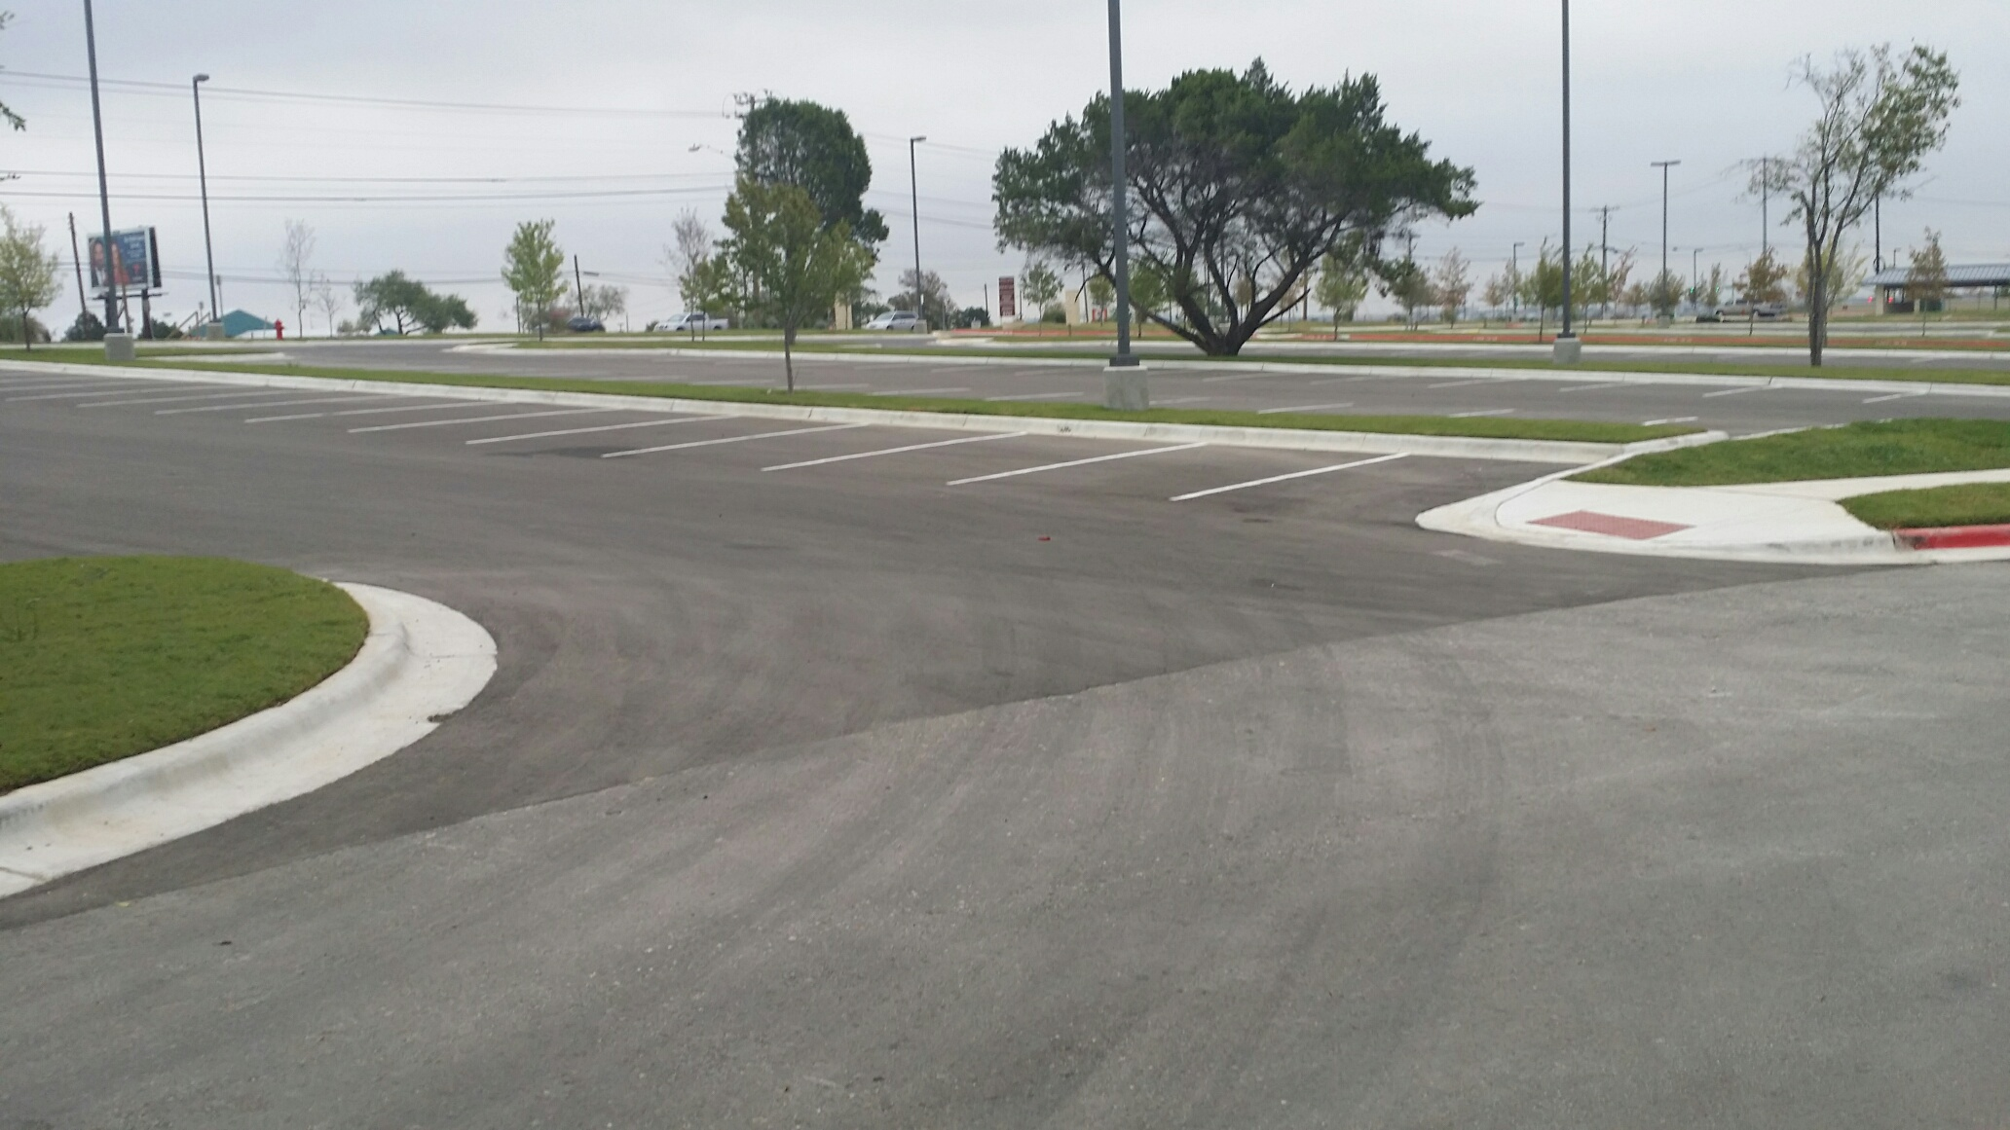
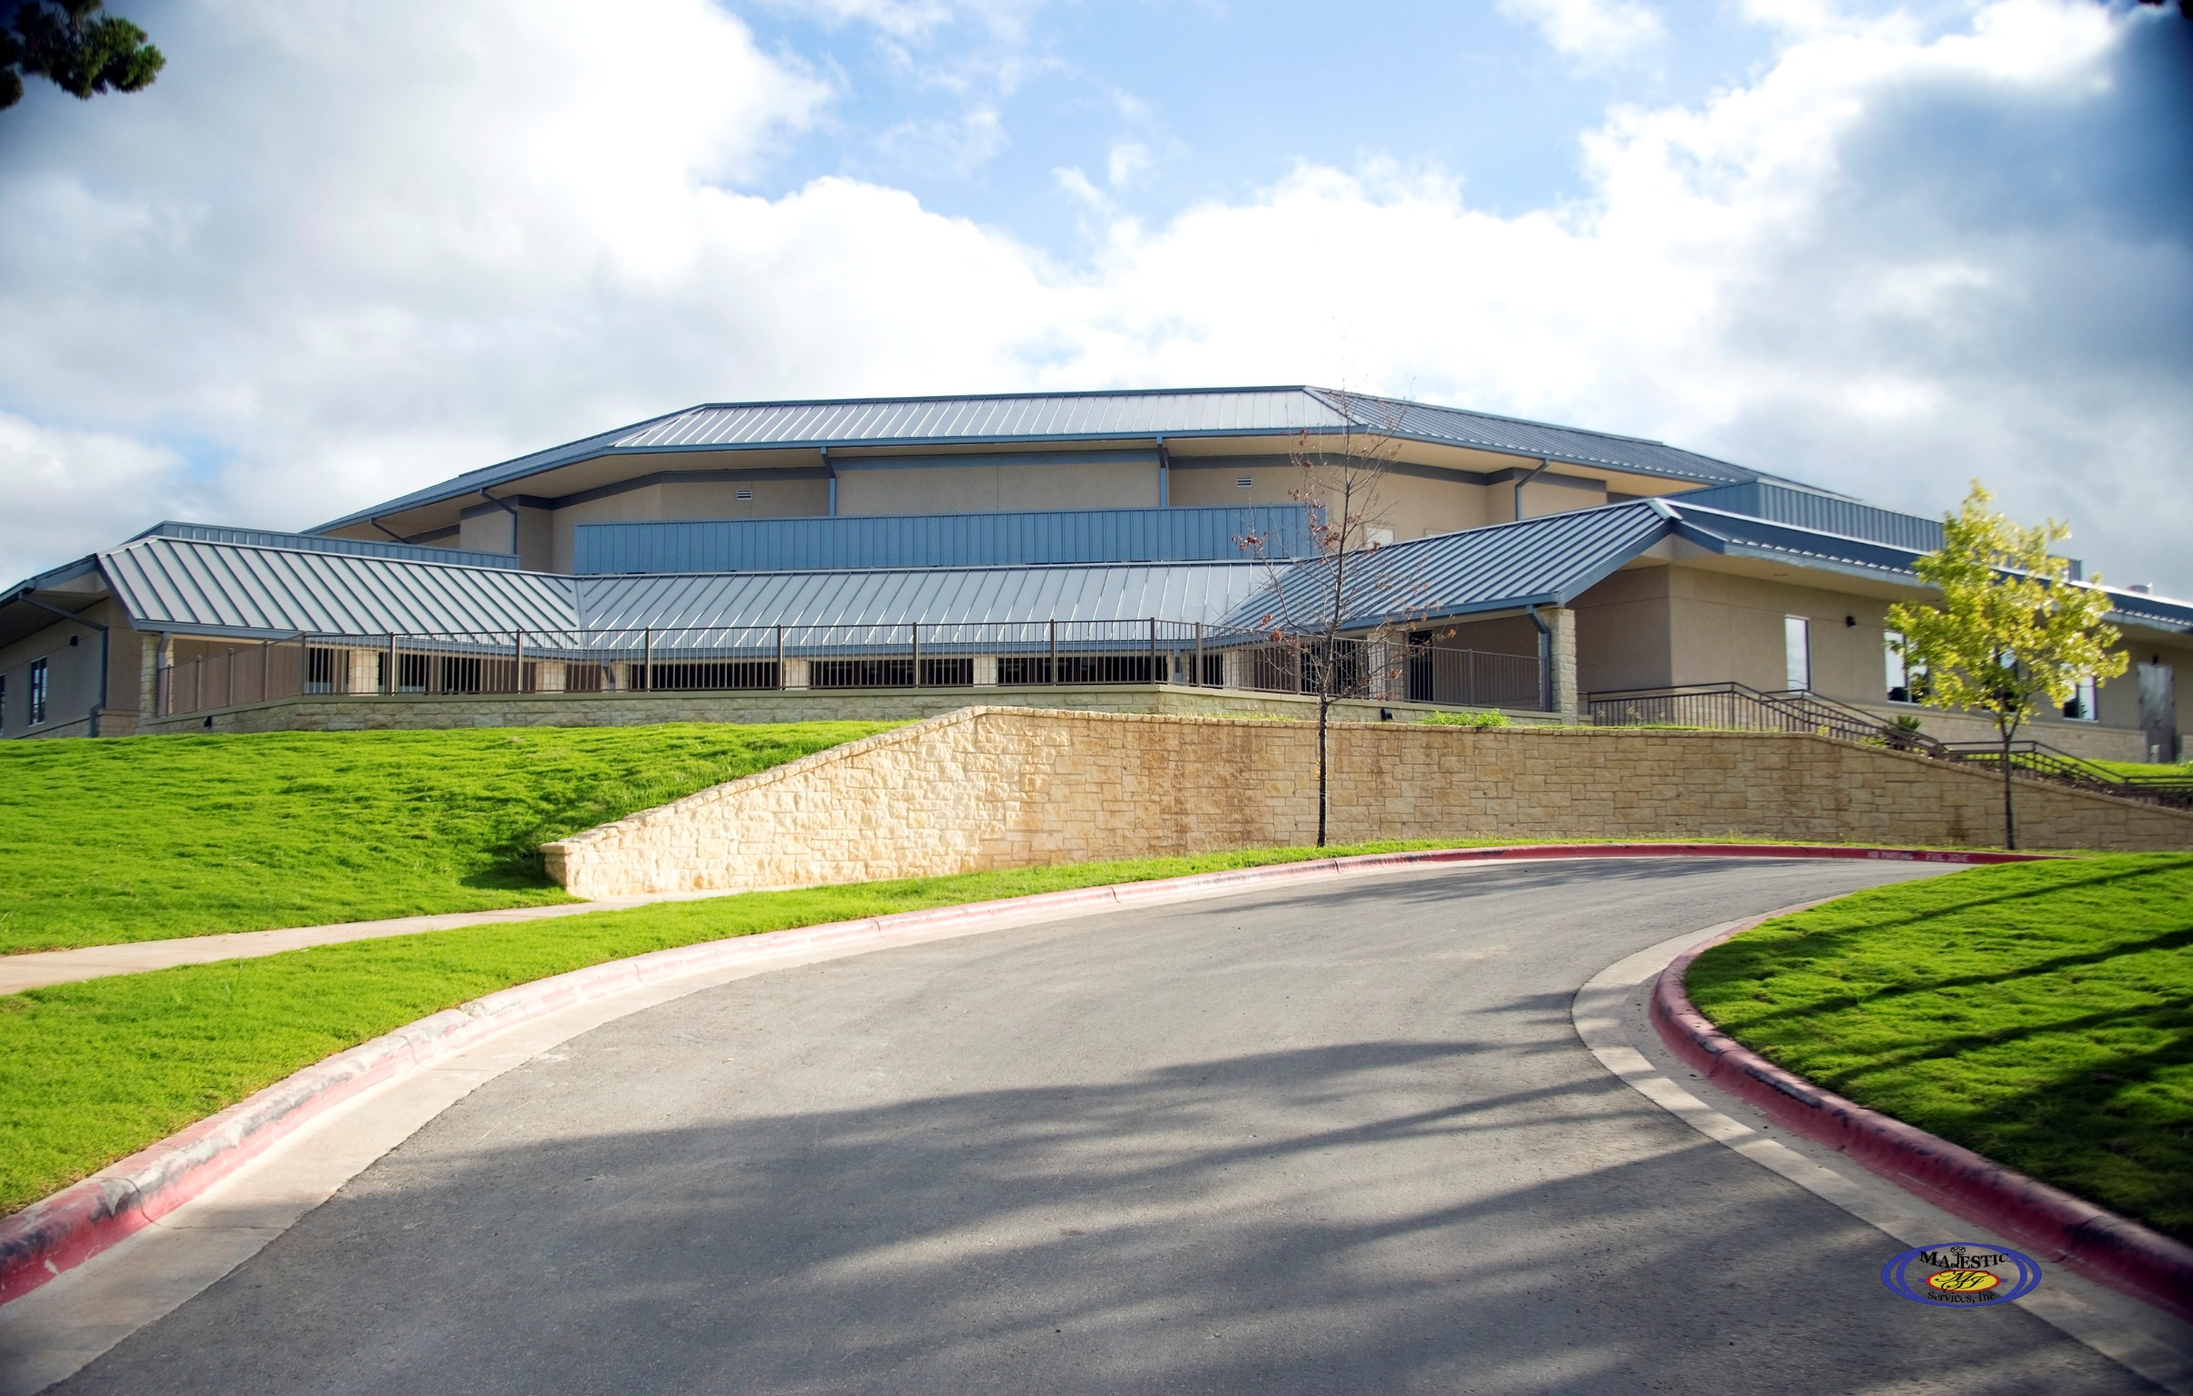
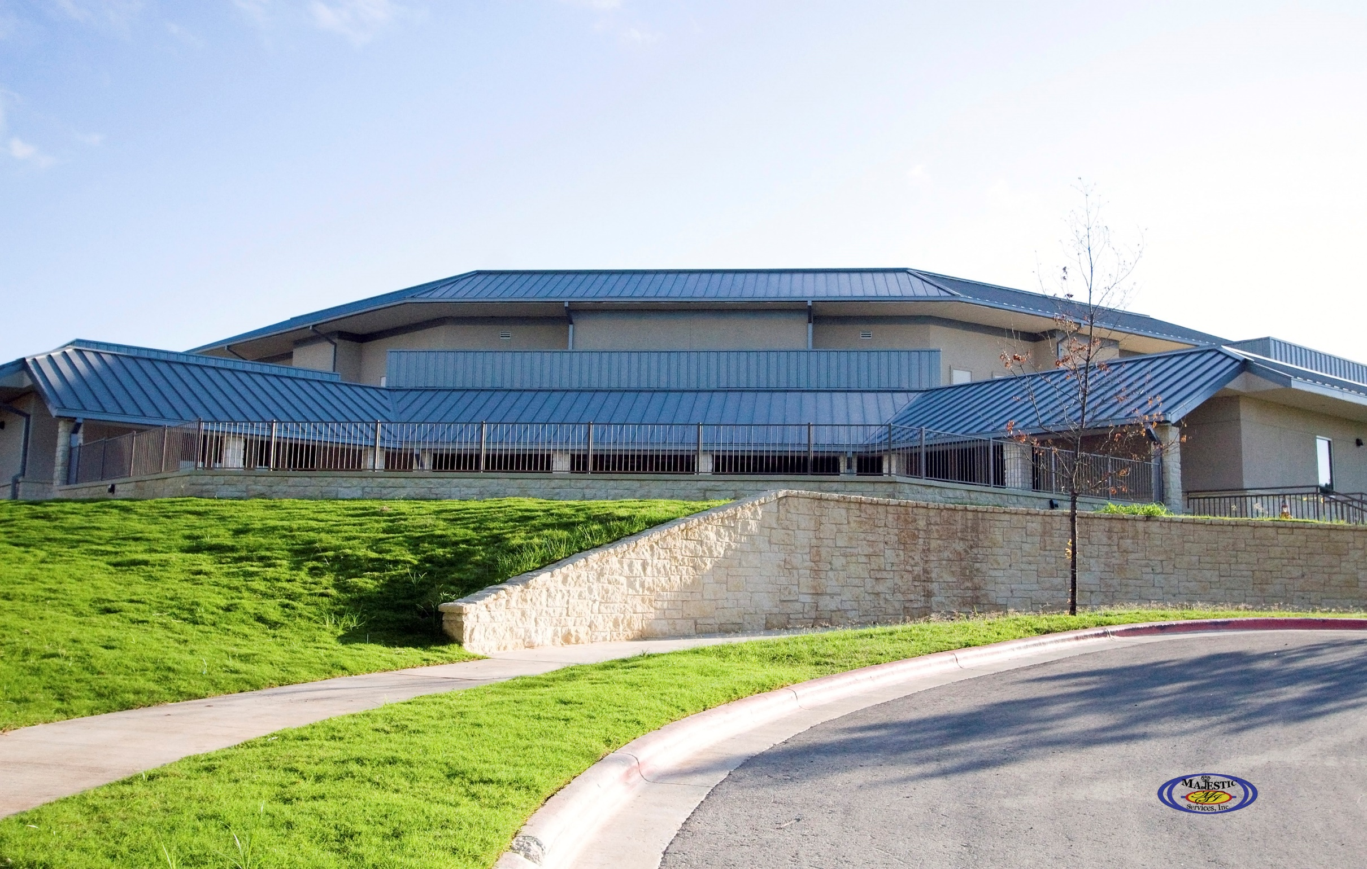
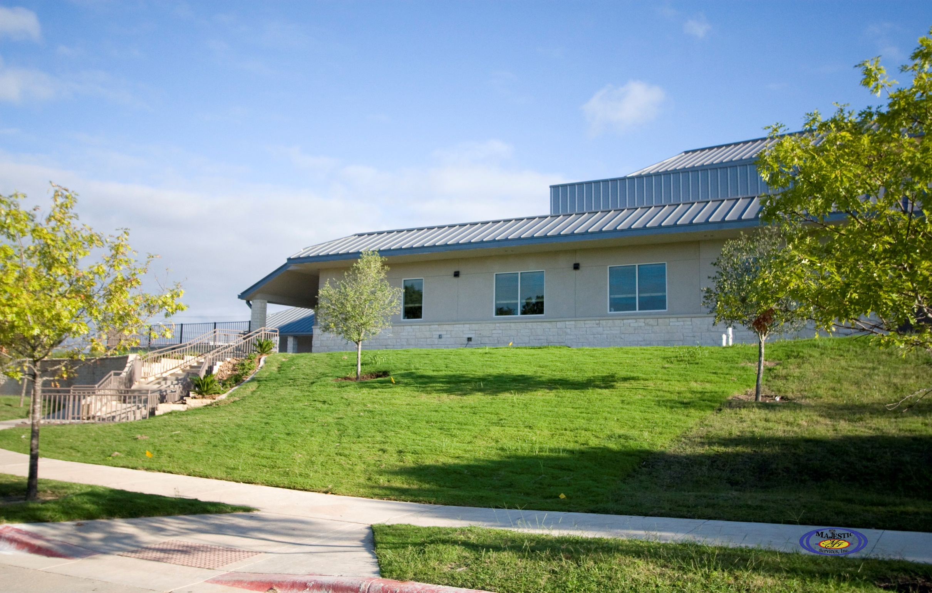
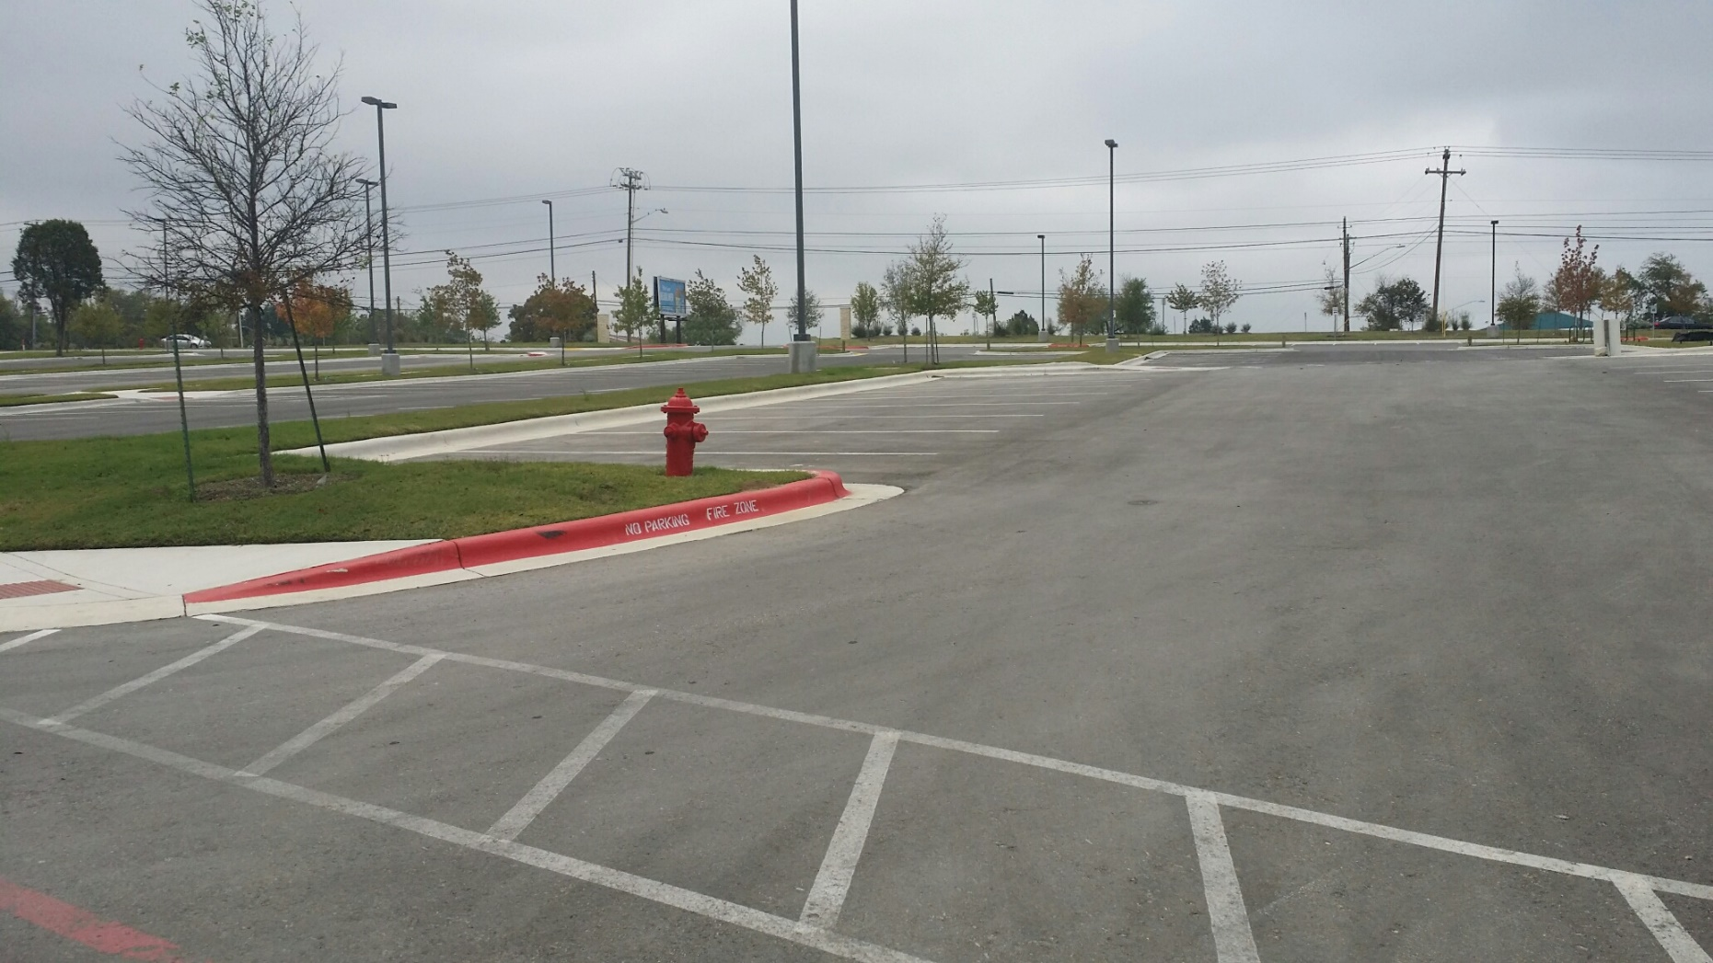

Slide 50
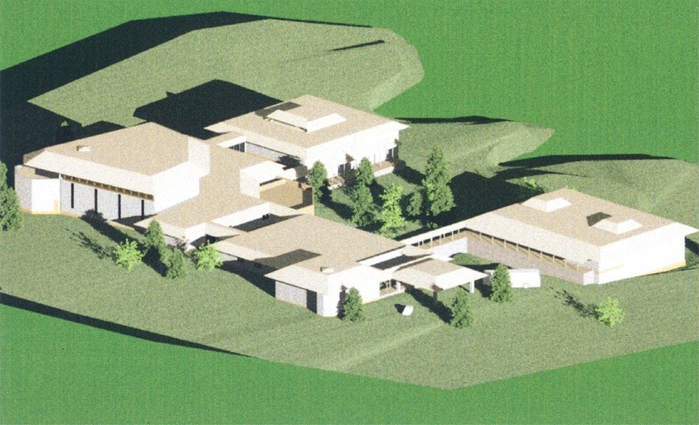
Project and Construction Management
East Side Church of Christ
Project/Construction Management
Master Site Planning
Site Assessment

Slide 51
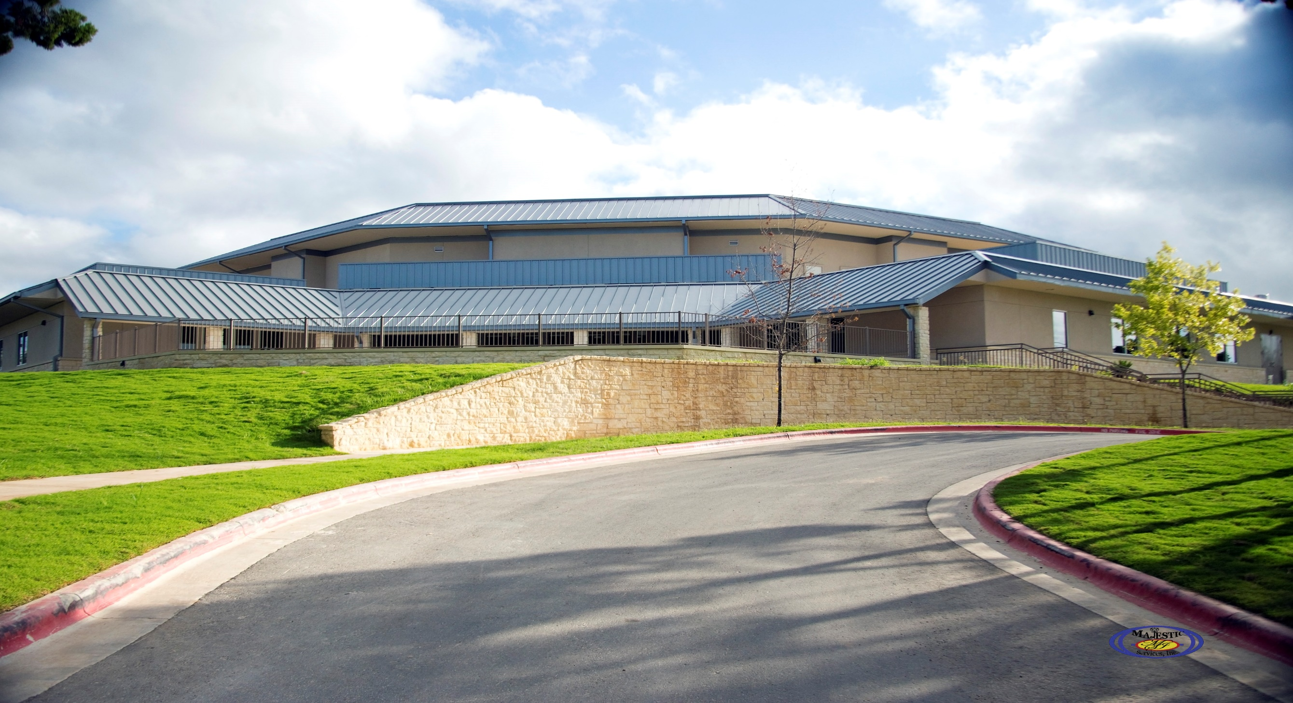

Slide 52

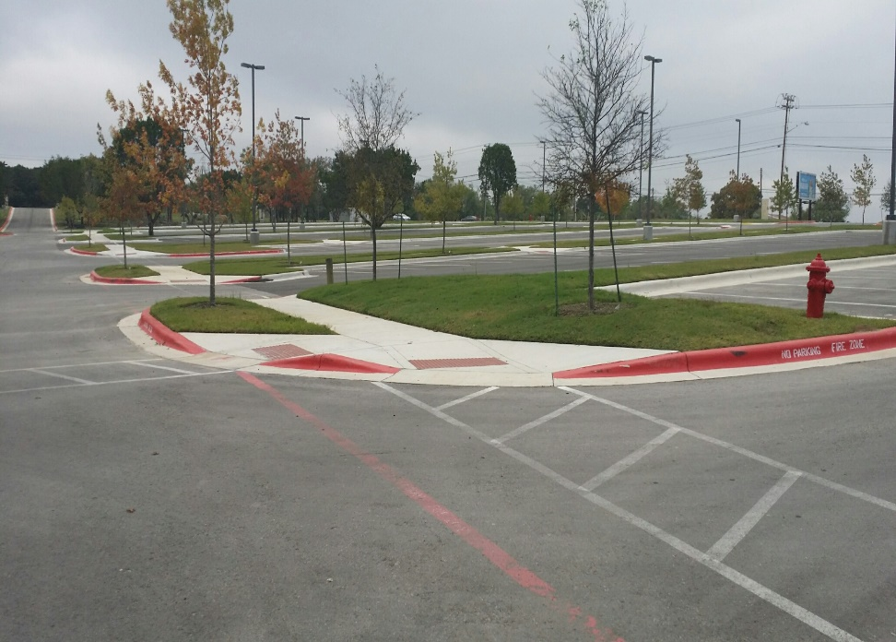

Slide 53
ST. JAMES MISSIONARY BAPTIST CHURCH

Slide 54
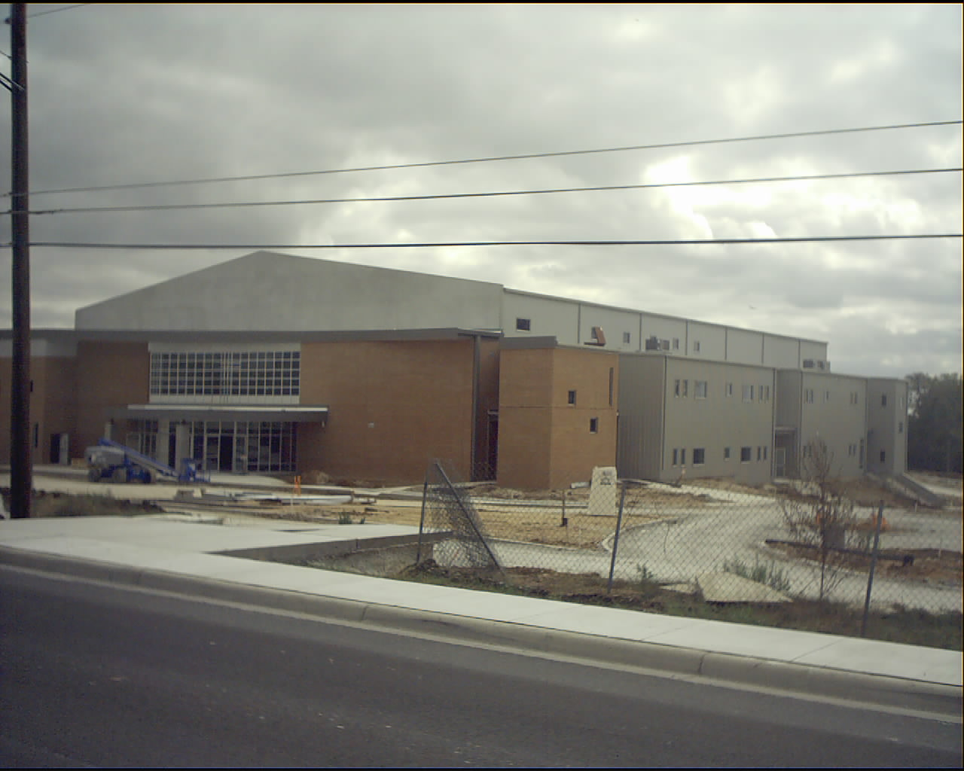
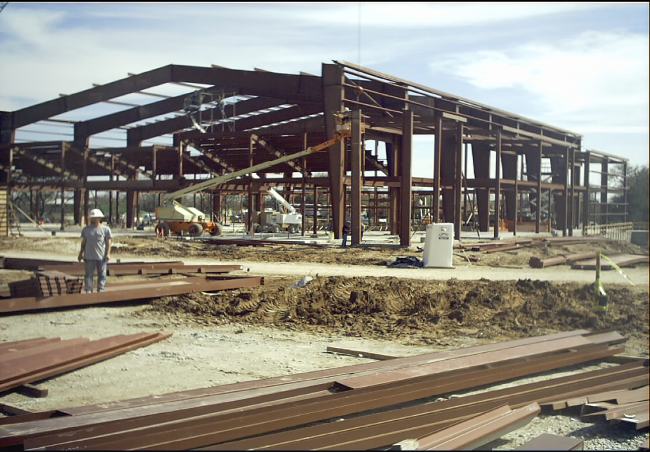
INSURANCE/BONDING/ ABOUT PRINCIPAL
INSURANCE
$2,000,000.00 Professional Liability Insurance
$1,000,000.00 General Liability Insurance
Workers Compensation Insurance
ST. James Baptist Church, Austin, TX ($6M
BONDING CAPACITY
$3,000,000 Bonding Capacity
ST. James Baptist Church, Austin, TX $6M
www.asdconsultantsinc.com

Slide 55
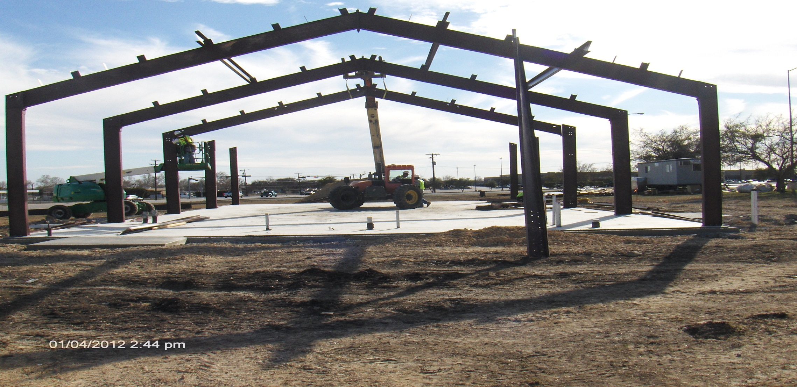

Slide 56
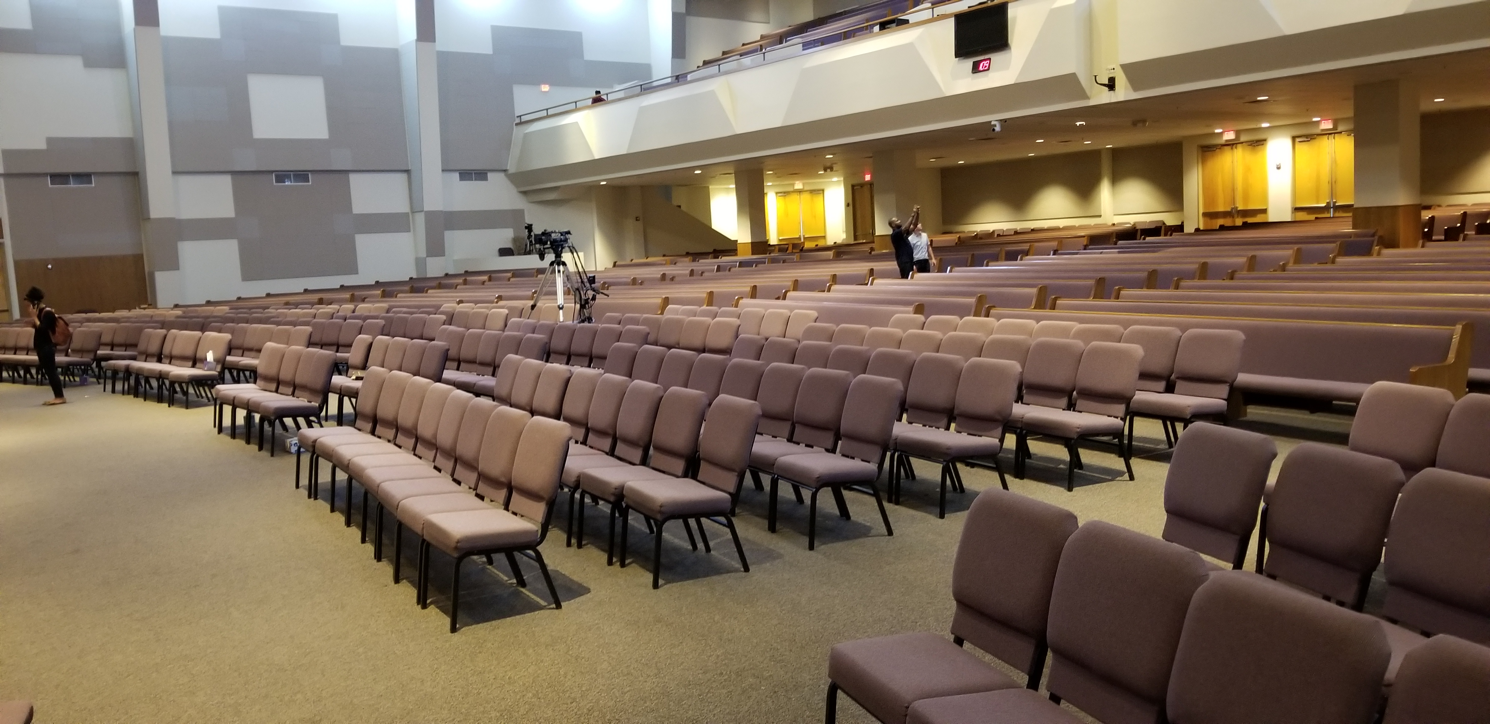

Slide 57
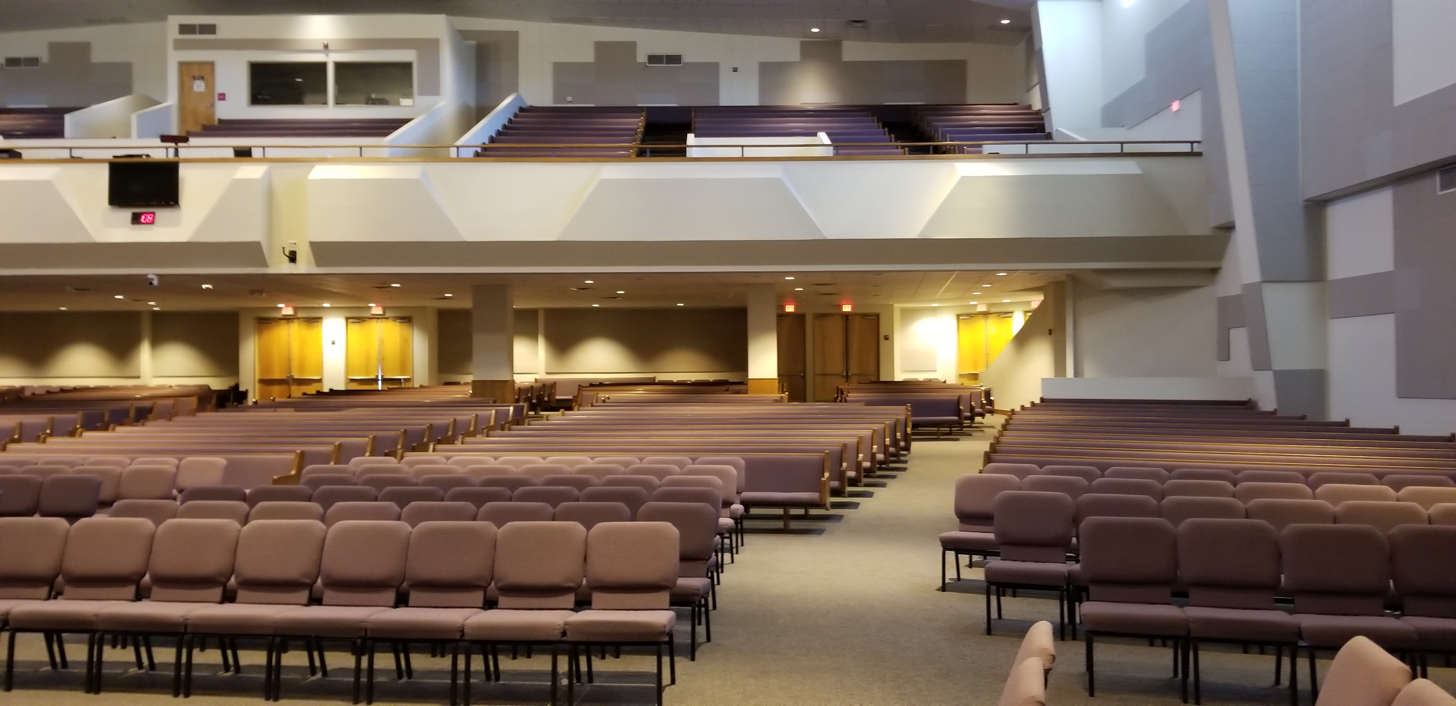

Slide 59
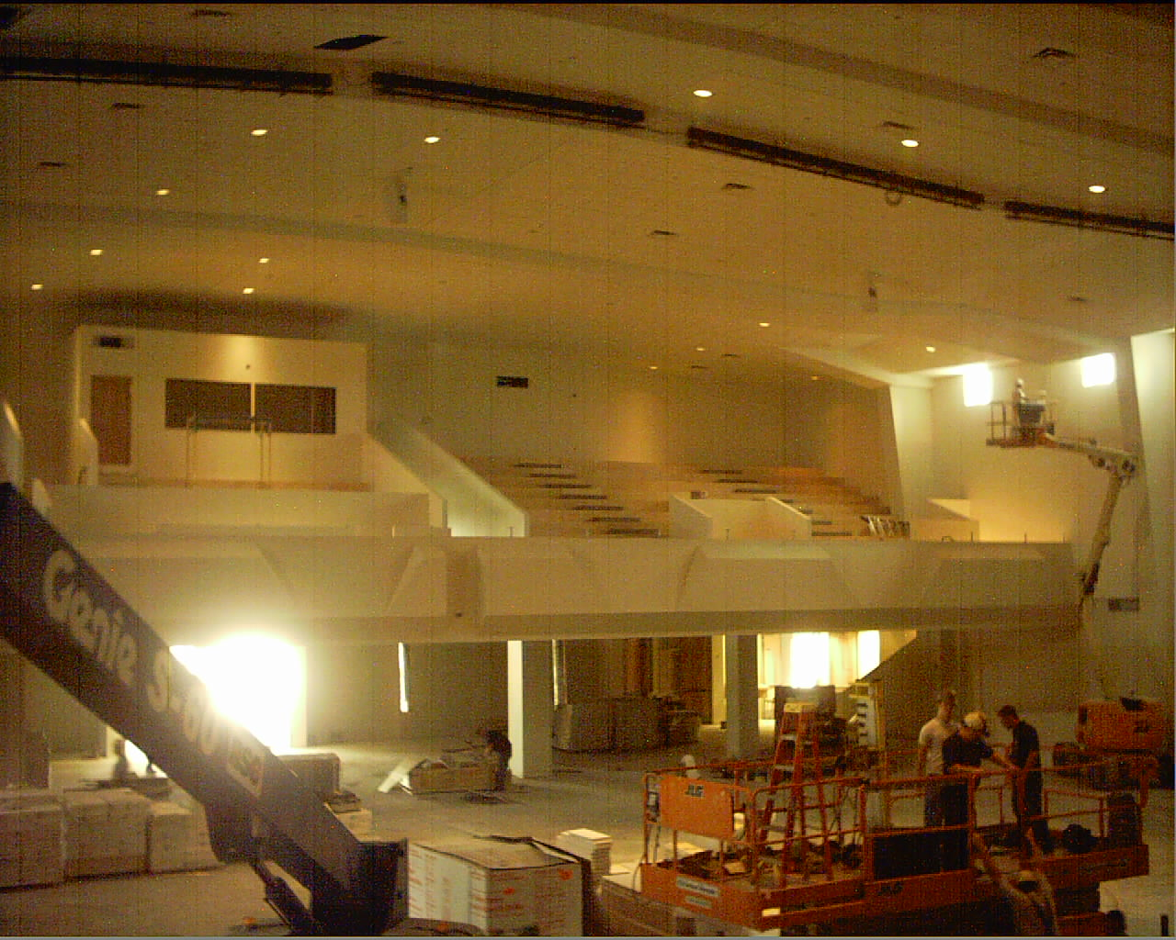

Slide 60
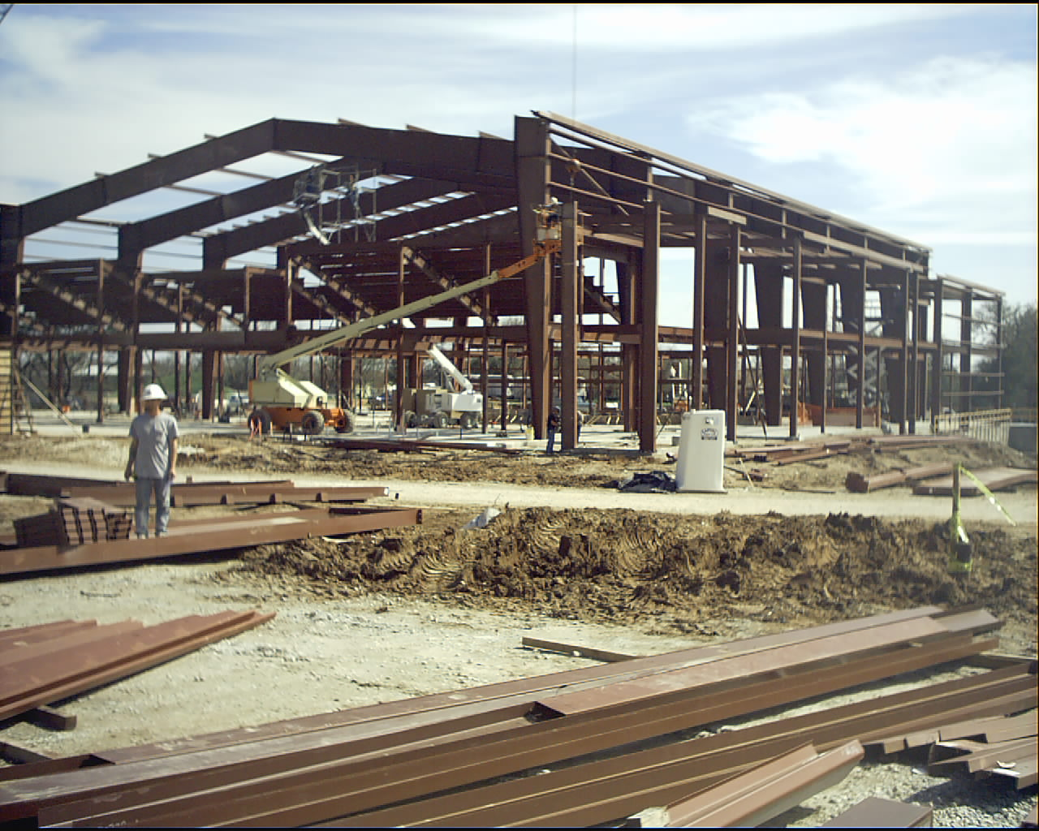

Slide 61
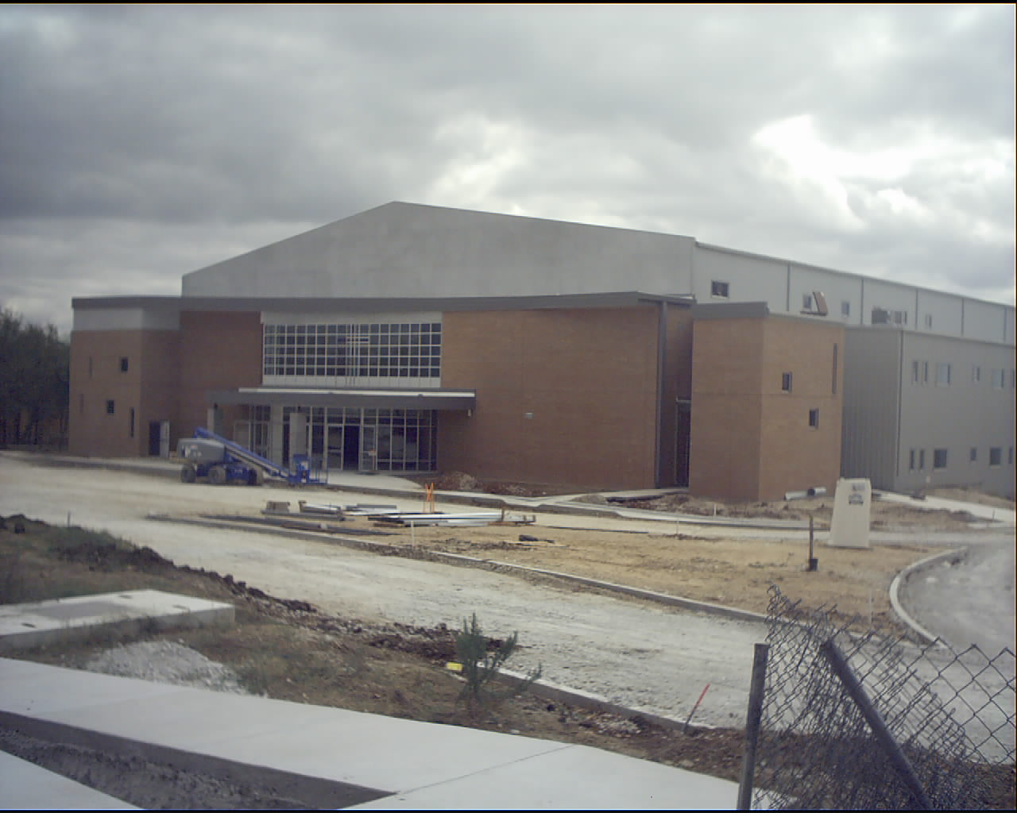

Slide 62
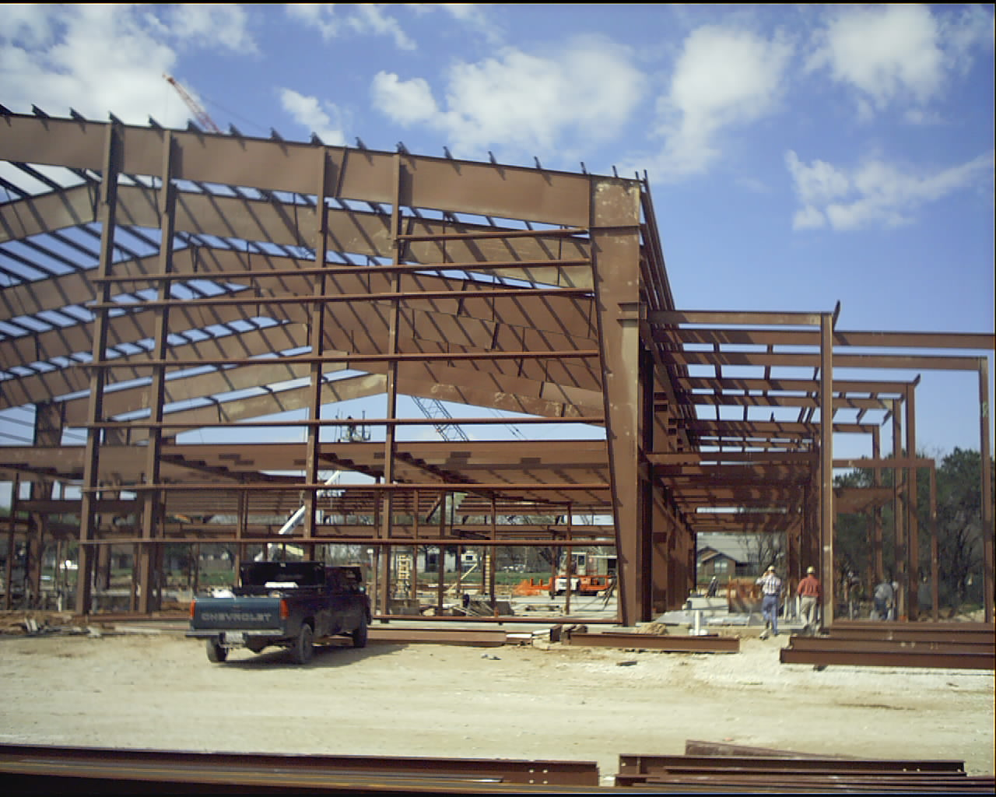
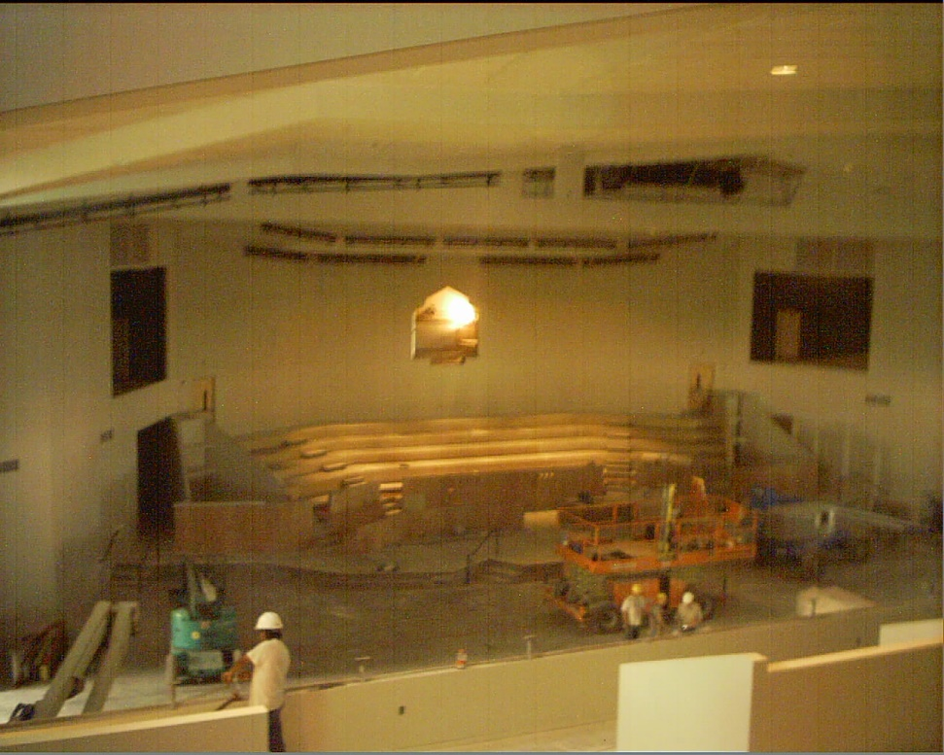

Slide 63
INSURANCE/BONDING/ ABOUT PRINCIPAL
INSURANCE
$2,000,000.00 Professional Liability Insurance
$1,000,000.00 General Liability Insurance
Workers Compensation Insurance
ST. James Baptist Church, Austin, TX ($6M
BONDING CAPACITY
$3,000,000 Bonding Capacity
ST. James Baptist Church, Austin, TX $6M
www.asdconsultantsinc.com

Slide 64
PILGRIM REST PRIMATIVE BAPTIST CHURCH

Slide 65
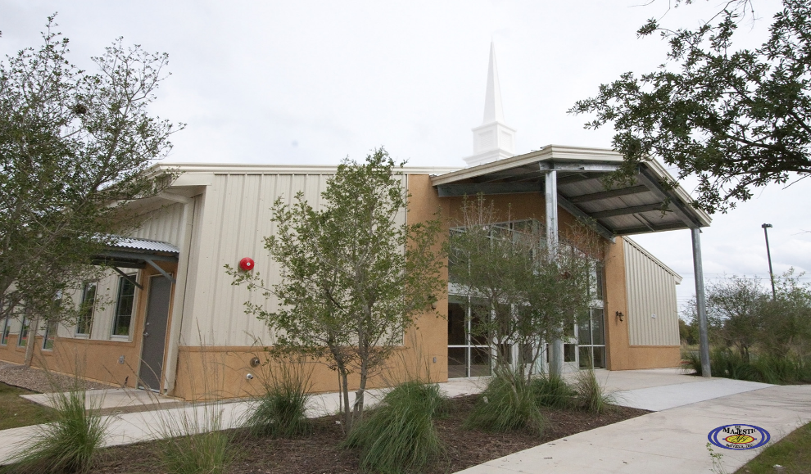
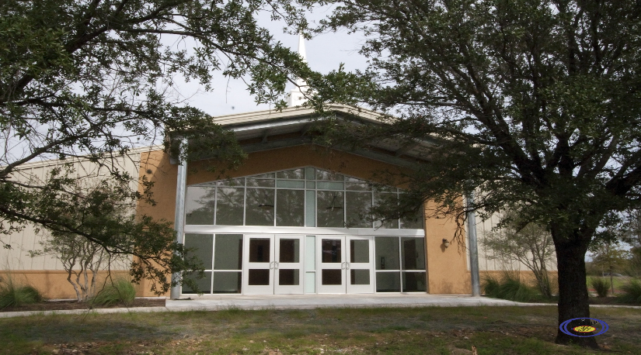
ABOUT ASD CONSULTANTS
ABOUT ASD CONSULTANTS, INC.
ASD Consultants, Inc. was established in 1994 as a multi-purpose consulting/construction firm, offering Project and Construction Management services; in addition ASD Consultants, Inc. provides detailed cost estimating services. Having completed over 400 individual projects with a collective value of over $1 Billion, our firm continues to be one of only a few full service companies, which is entirely specialized in its fields of expertise. ASD Consultants, Inc. is managed by architectural and construction professionals. Our staff is thoroughly experienced in project management, quality control, construction management and cost controls.
New Pilgrim Rest Primitive Baptist Church Austin, TX $1M
COPORATE OFFICE
ASD Consultants, Inc.
8120 NORTH IH 35
Suite B200
Austin, Texas 78753
Phone: (512) 836-3329
Fax: (512) 836-3802
E-Mail: mail@asdconsultantsinc.com
Web Address: www.asdconsultantsinc.com
New Pilgrim Rest Primitive Baptist Church Austin, TX $1M
www.asdconsultantsinc.com

Slide 66


Slide 67
ABOUT ASD CONSULTANTS
ABOUT ASD CONSULTANTS, INC.
ASD Consultants, Inc. was established in 1994 as a multi-purpose consulting/construction firm, offering Project and Construction Management services; in addition ASD Consultants, Inc. provides detailed cost estimating services. Having completed over 400 individual projects with a collective value of over $1 Billion, our firm continues to be one of only a few full service companies, which is entirely specialized in its fields of expertise. ASD Consultants, Inc. is managed by architectural and construction professionals. Our staff is thoroughly experienced in project management, quality control, construction management and cost controls.
New Pilgrim Rest Primitive Baptist Church Austin, TX $1M
COPORATE OFFICE
ASD Consultants, Inc.
8120 NORTH IH 35
Suite B200
Austin, Texas 78753
Phone: (512) 836-3329
Fax: (512) 836-3802
E-Mail: mail@asdconsultantsinc.com
Web Address: www.asdconsultantsinc.com
New Pilgrim Rest Primitive Baptist Church Austin, TX $1M
www.asdconsultantsinc.com

Slide 68
19TH STREET BAPTIST BAPTIST CHURCH

Slide 69
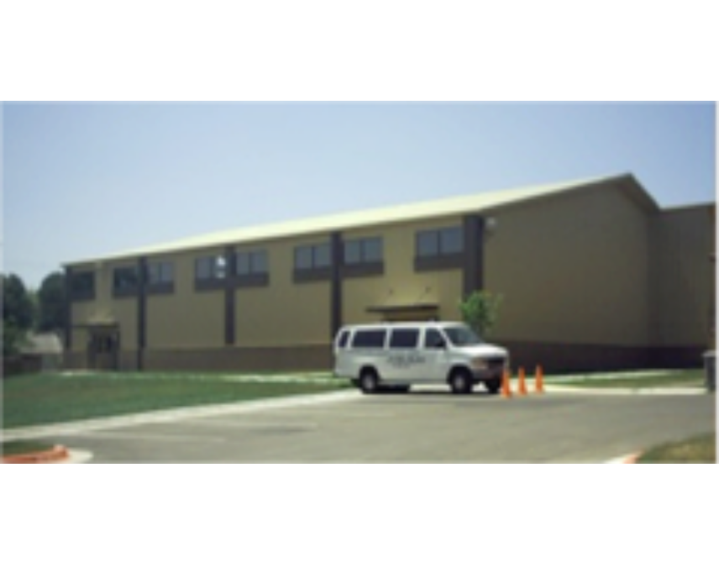
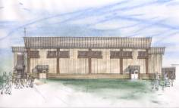
MEMBERSHIPS/CERTIFICATONS
MEMBERSHIPS (CONTINUE)
Association of General Contractors (AGC)
National Association of Minority Contractors
National Council of Architectural Registration Boards (NCARB)
Member City of Austin Fire Code Review Board
19th Street Baptist Church Family Life Center, Austin, TX $1.1M
MEMBERSHIPS
American Institute of Architects (AIA)
Construction Specifications Institute (CSI)
National Organization of Minority Architects (NOMA)
National Roofing Association (NRA)
19th Street Baptist Church Family Life Center, Austin, TX $1.1M
www.asdconsultantsinc.com

Slide 70
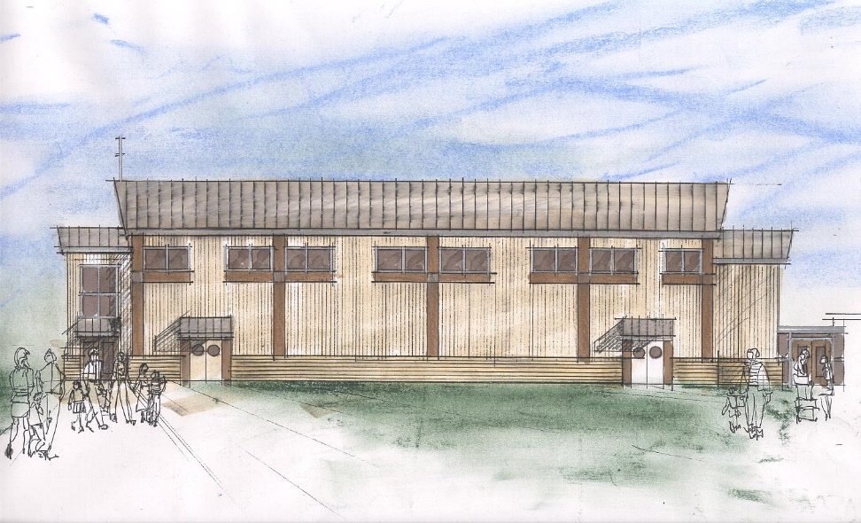
Project and Construction Management
19th Street Baptist Church
Feasibility Study
Asbestos Survey
Consultant Selection
Project Management
Construction Management

Slide 71
Project and Construction Management
19th Street Baptist Church
Feasibility Study
Asbestos Survey
Consultant Selection
Project Management
Construction Management

Slide 72
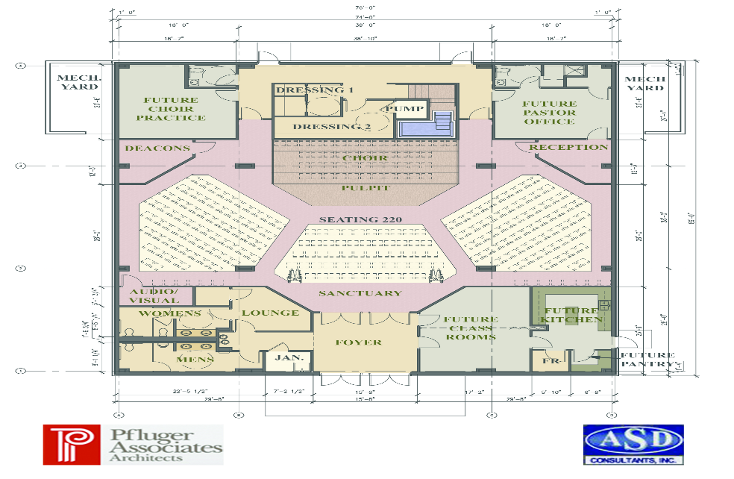
MEMBERSHIPS/CERTIFICATONS
MEMBERSHIPS (CONTINUE)
Association of General Contractors (AGC)
National Association of Minority Contractors
National Council of Architectural Registration Boards (NCARB)
Member City of Austin Fire Code Review Board
19th Street Batist Church Family Life Center, Austin, TX (1.1 million)
MEMBERSHIPS
American Institute of Architects (AIA)
Construction Specifications Institute (CSI)
National Organization of Minority Architects (NOMA)
National Roofing Association (NRA)
New Pilgrim Rest Primative Baptist Church Austin, TX ( 1 million)
www.asdconsultantsinc.com

Slide 73
GOODFELLOW AIR FORCE BASE CHAPEL

Slide 74

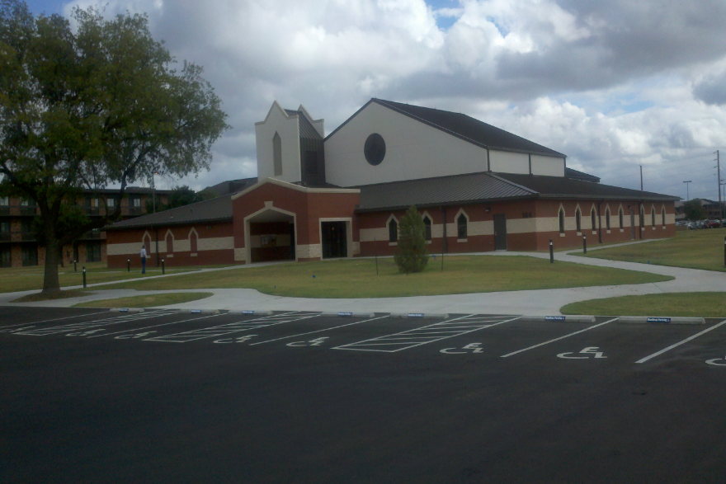

Goodfellow Chapel, San Angelo, TX (5 million)
Goodfellow Chapel, San Angelo, TX (5 million)
GENERAL CONTRACTOR
FOR YOUR COMMERCIAL NEEDS

Slide 75


Slide 76


Slide 77


Slide 78
Goodfellow Chapel, San Angelo, TX $5M
Goodfellow Chapel, San Angelo, TX $5M
GENERAL CONTRACTOR
FOR YOUR COMMERCIAL NEEDS

Slide 79
Goodfellow Chapel, San Angelo, TX $5M
Goodfellow Chapel, San Angelo, TX $5M
GENERAL CONTRACTOR
FOR YOUR COMMERCIAL NEEDS

Slide 80


Slide 81


Slide 82
MISC. CHURCHES THAT ASD CONSULTANTS, INC. PROVIDED PROFESSIONAL SERVICES FOR

Slide 83



ABOUT CURTIS BROWN, AIA
ABOUT CURTIS BROWN, AIA
CURTIS BROWN, AIA
30 Years Experience
Licensed Architect
Licensed Interior Designer
Licensed General Contractor (North Carolina)
Solid Rock Baptist Church, Austin, TX (Feasibility Study)
Mount Zion Baptist Church, Austin, TX (Feasibility Study)
David Chapel Baptist Church Austin, TX (Feasibility Study)
www.asdconsultantsinc.com

Slide 84

Project and Construction Management
PROJECT
MANAGEMENT
Abundant Life Christian
Church
Site Assessment
Feasibility Study

Slide 85
Project and Construction Management
Mount Zion Baptist
Church
Feasibility Study
Asbestos Survey

Slide 86


Project and Construction Management
Mount Sinai Baptist
Church
Feasibility Study
Asbestos Survey
Site Feasibility Study
SITE DEVELOPMENT ANALYSIS / ENVIRONMENTAL
ASBESTOS SURVEY
FOR
THE MOUNT SINAI MISSIONARY BAPTIST CHURCH
5900 CAMERON RD.
AUSTIN, TX 78723
ASD # 20012

Slide 87
Project and Construction Management
David Chapel Baptist
Church
Feasibility Study
Asbestos Survey

Slide 88
Project and Construction Management
Solid Rock Baptist Church
Feasibility Study

Slide 89
ABOUT CURTIS BROWN, AIA
ABOUT CURTIS BROWN, AIA
CURTIS BROWN, AIA
30 Years Experience
Licensed Architect
Licensed Interior Designer
Licensed General Contractor (North Carolina)
Solid Rock Baptist Church, Austin, TX (Feasibility Study)
Mount Zion Baptist Church, Austin, TX (Feasibility Study)
David Chapel Baptist Church Austin, TX (Feasibility Study)
www.asdconsultantsinc.com

Slide 90
ABOUT CURTIS BROWN, AIA
ABOUT CURTIS BROWN, AIA
CURTIS BROWN, AIA
30 Years Experience
Licensed Architect
Licensed Interior Designer
Licensed General Contractor (North Carolina)
Solid Rock Baptist Church, Austin, TX (Feasibility Study)
Mount Zion Baptist Church, Austin, TX (Feasibility Study)
David Chapel Baptist Church Austin, TX (Feasability Study)
www.asdconsultantsinc.com

Slide 91
MISC. CHURCHES DESIGNED BUT NOT CONSTRUCTED

Slide 92


CHURCH PROJECTS
Abundant Life Church, San Marcos, TX $850K
Abundant Lift Church, San Marcos, TX $850K
www.asdconsultantsinc.com

Slide 93

CHURCH PROJECTS
Great Commission Baptist Church, Austin, TX $800K
Great Commission Baptist Church, Austin TX $800K
www.asdconsultantsinc.com

Slide 94


CHURCH PROJECTS
St. Mary’s Baptist Church, Lake Charles, LA $2.3M
St. Mary’s Baptist Church, Lake Charles, LA $2.3M
www.asdconsultantsinc.com

Slide 95

CHURCH PROJECTS
Abundant Life Church, San Marcos, TX $850K
Abundant Lift Church, San Marcos, TX $850K
www.asdconsultantsinc.com

Slide 96
CHURCH PROJECTS
Great Commission Baptist Church, Austin, TX $800K
Great Commission Baptist Church, Austin TX $800K
www.asdconsultantsinc.com

Slide 97
CHURCH PROJECTS
St. Mary’s Baptist Church, Lake Charles, LA $2.3M
St. Mary’s Baptist Church, Lake Charles, LA $2.3M
www.asdconsultantsinc.com

Slide 98



Slide 99


Slide 100

ABOUT ASD CONSULTANTS
ABOUT ASD CONSULTANTS, INC.
ASD Consultants, Inc. was established in 1994 as a multi-purpose consulting/construction firm, offering Project and Construction Management services; in addition ASD Consultants, Inc. provides detailed cost estimating services. Having completed over 400 individual projects with a collective value of over $1 Billion, our firm continues to be one of only a few full service companies, which is entirely specialized in its fields of expertise. ASD Consultants, Inc. is managed by architectural and construction professionals. Our staff is thoroughly experienced in project management, quality control, construction management and cost controls.
New Pilgrim Rest Primative Baptist Church Austin, TX ( 1 million)
COPORATE OFFICE
ASD Consultants, Inc.
8120 NORTH IH 35
    Suite B200
  Austin, Texas 78753
  Phone: (512) 836-3329
  Fax: (512) 836-3802
  E-Mail: mail@asdconsultantsinc.com
  Web Address: www.asdconsultantsinc.com
www.asdconsultantsinc.com

Slide 101


Slide 102
ASD CONSULTANTS, INC. AWARDS

Slide 103


ASD Consultants, Inc.
- Project Manager - Construction Manager - Cost Estimator

Slide 104

AUSTIN BUSINESS
JOURNAL
Article on ASD’s performance on the Austin-Bergstrom International Airport Parking Garage

Slide 105

ASD Consultants, Inc
was selected as “Consultants
of the Year “ by the Texas
Association of Minority
and Business Enterprises

Slide 106

AWARDS
1994 Appreciation Award for the Design of the Woman’s Place at Brackenridge
Hospital

Slide 107

AWARDS
1988 Award for the Renovation to the Dougherty Arts Center

